Slide 1
Surrealism- 1 and 2 Point Perspective

Slide 2
Craig Blair
Surreal Artwork
Strange and Unusual
Objects don’t usually go together
Dream-like/ Mystery
Developed during WW1 and WW2

Slide 3
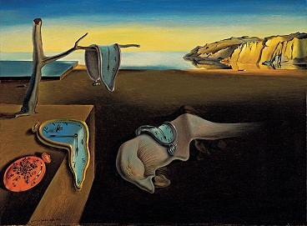

Slide 8
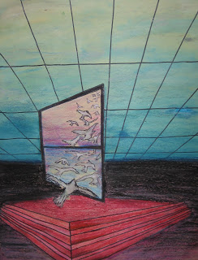

Slide 9
Day 1:
Gather ideas and inspiration from magazines, etc.
Create 4 sketches of your composition, or layout
CRITERIA:
Artwork must show mystery created by shadows or other dark areas, silhouettes, etc.
(Mystery can also be created by your combinations of objects (e.g. objects that might not normally go together.)
A patterned floor- Think of tiles or stars. Anything with repetition
A door, window, half-wall or opening of some kind
3 Walls total (No ceiling)
At least 3 objects
ADDITIONAL VA COMP REQUIREMENTS:
Specific color scheme must be chosen: Primary, secondary, warm, cool, analogous, etc.
One object drawn from 2-point perspective (think of a simple geometric object- box, TV, suitcase, etc)

Slide 10
Day 2: One and Two Point Perspective Mini Lesson
Video: https://www.youtube.com/watch?v=7ZYBWA-ifEs
Finish thumbnails and Choose composition.

Slide 11
Criteria:
Composition (Layout) based on 1-point perspective.
Artwork must show mystery created by shadows or other dark areas, silhouettes, etc.
(Mystery can also be created by your combinations of objects (e.g. objects that might not normally go together.)
The composition must include:
A patterned floor, floor covering or walkway or staircase that follows the rules of 1 point perspective.
A door, window, half-wall or opening of some kind between the foreground/middle ground space and the background space.
3 Walls (No ceiling)
At least 3 objects
ADDITIONAL VA COMP REQUIREMENTS:
Specific color scheme must be chosen: Primary, secondary, warm, cool, anagolous, etc.
One object drawn from 2-point perspective (a suitcase, a television, a box, etc.).

Slide 12
1 Point Perspective

Slide 13
Day 3+
Break foreground and background with opening.
Give the floor a design
Add interest to the “space”
Add geometric and organic shapes
Add object in 2 point perspective (VA COMP)
Add color and value (light and dark areas)

