Slide 1
Alternative Canvas

Slide 2
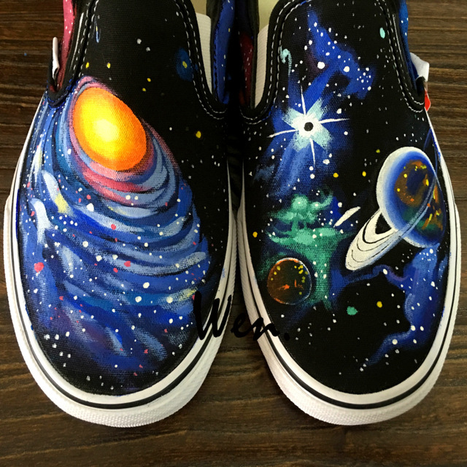

Slide 3
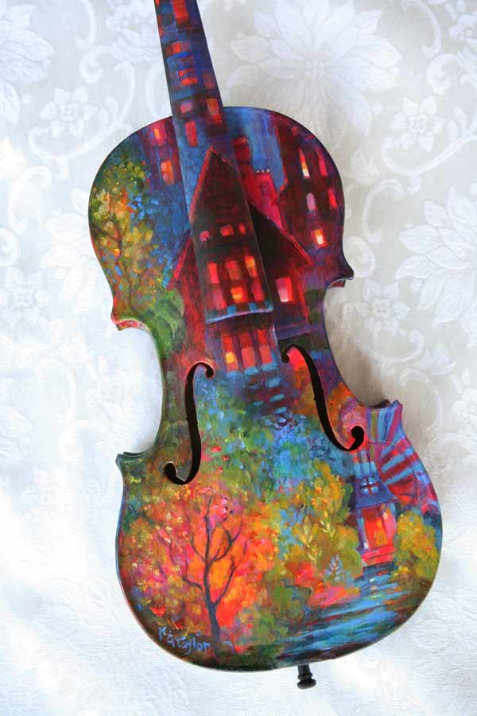

Slide 4
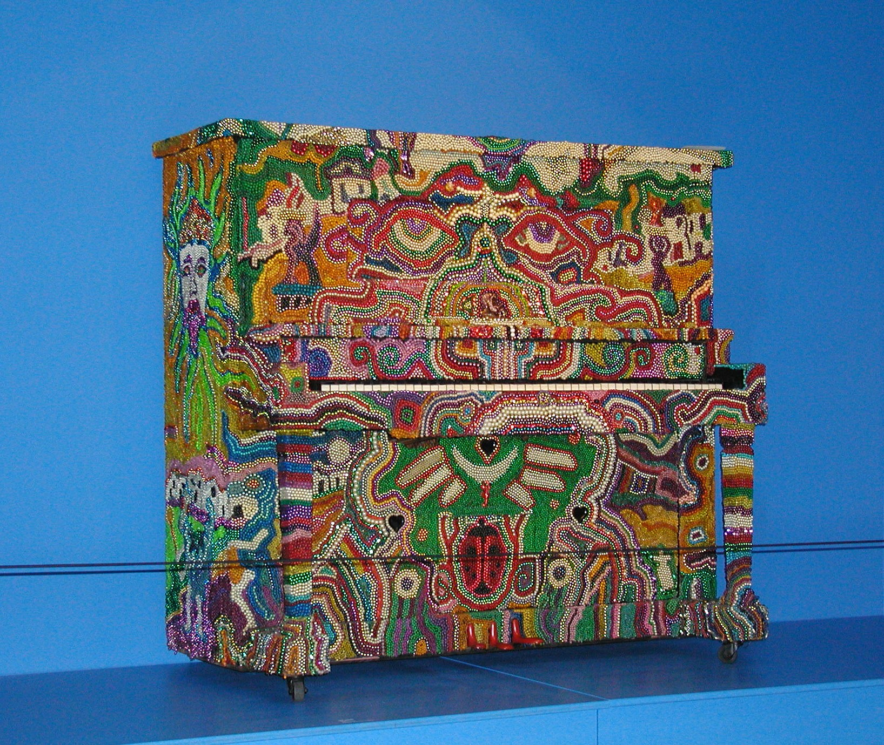

Slide 5
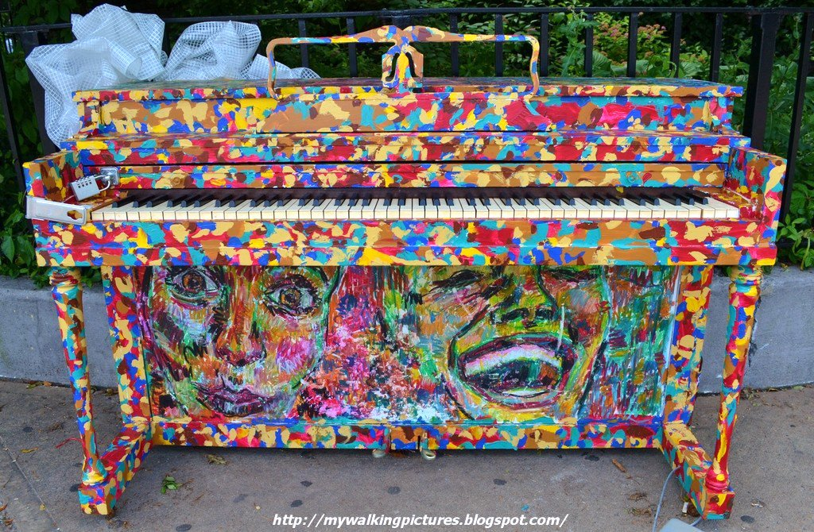

Slide 6
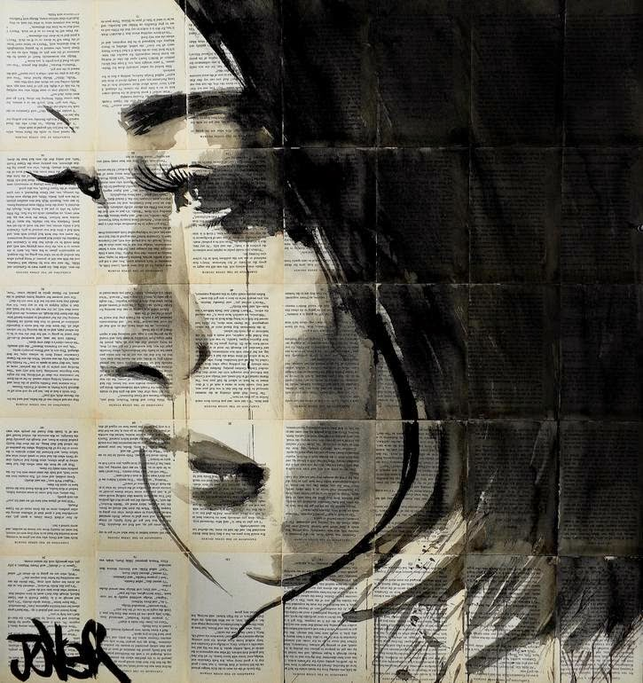

Slide 7
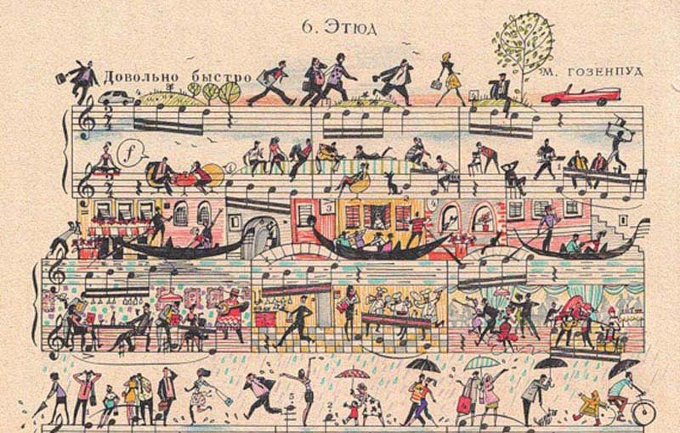

Slide 8
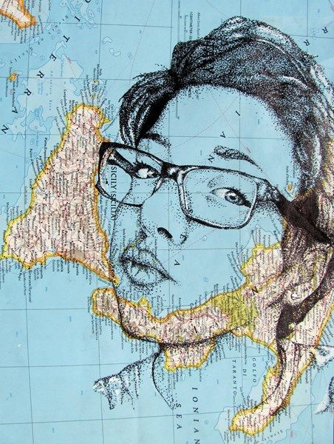

Slide 9
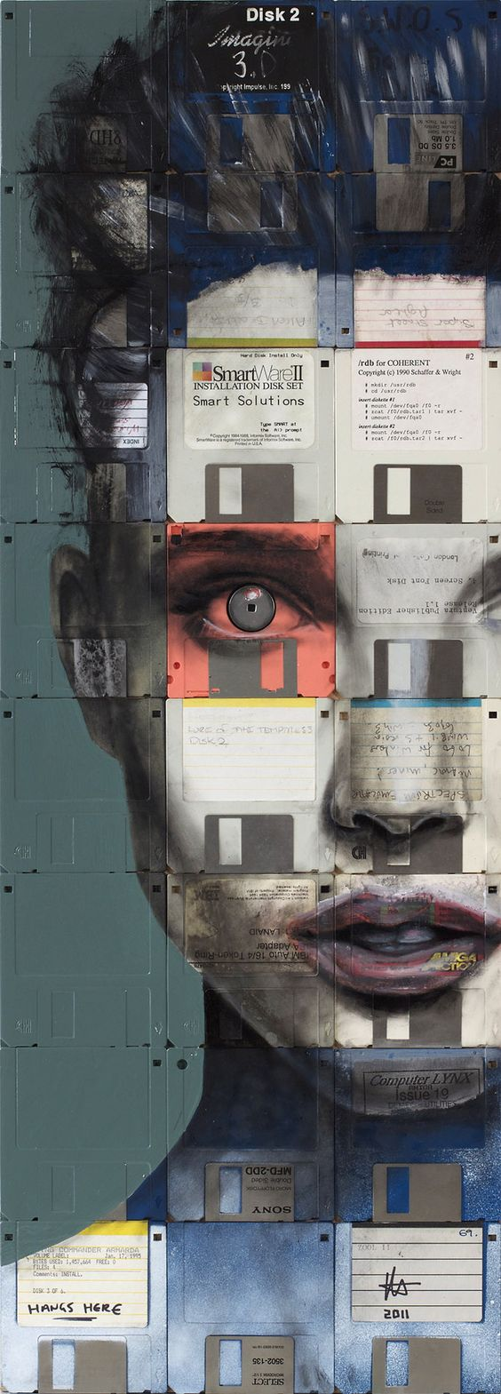

Slide 10
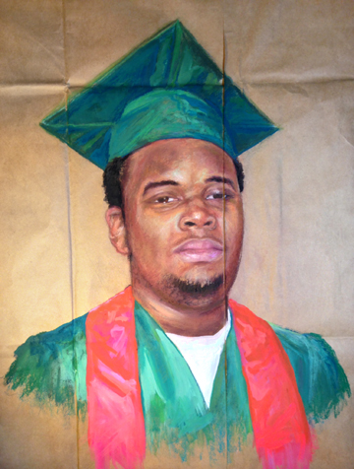
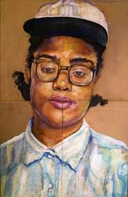
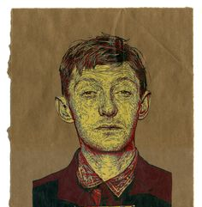

Slide 11
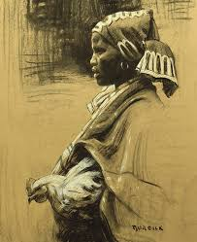

Slide 12
Typical Mediums
Watercolor
Acrylic Paint
Tempra Paint
Collage
Ceramics
Colored Pencil
Marker
Pen and Ink
Chalk Pastel
Oil Pastel
Charcoal
Graphite
Printmaking
Collage
Mixed Media

Slide 13
Typical Surfaces
Canvas
Paper (watercolor, drawing, printmaking, construction, butcher paper etc.)
Fabric (regular or alternative- clothing, shoes, bags, etc.)
Cardboard
Plastic sheets
Sidewalks
Concrete
Metal

Slide 14
Unusual Surfaces or Mediums
Coffee/ tea/ berries for paint or dyes
Makeup (eyeshadow) as pastel
Maps for surface
Blueprints for surface
Wood
Rocks
Paper Bags
Old Game Boards
Records
SURFACES MUST BE BROUGHT IN MONDAY

Slide 15
Today’s Goal
Create 3 designs using different media, surfaces and concepts. Label as well.

