Slide 1
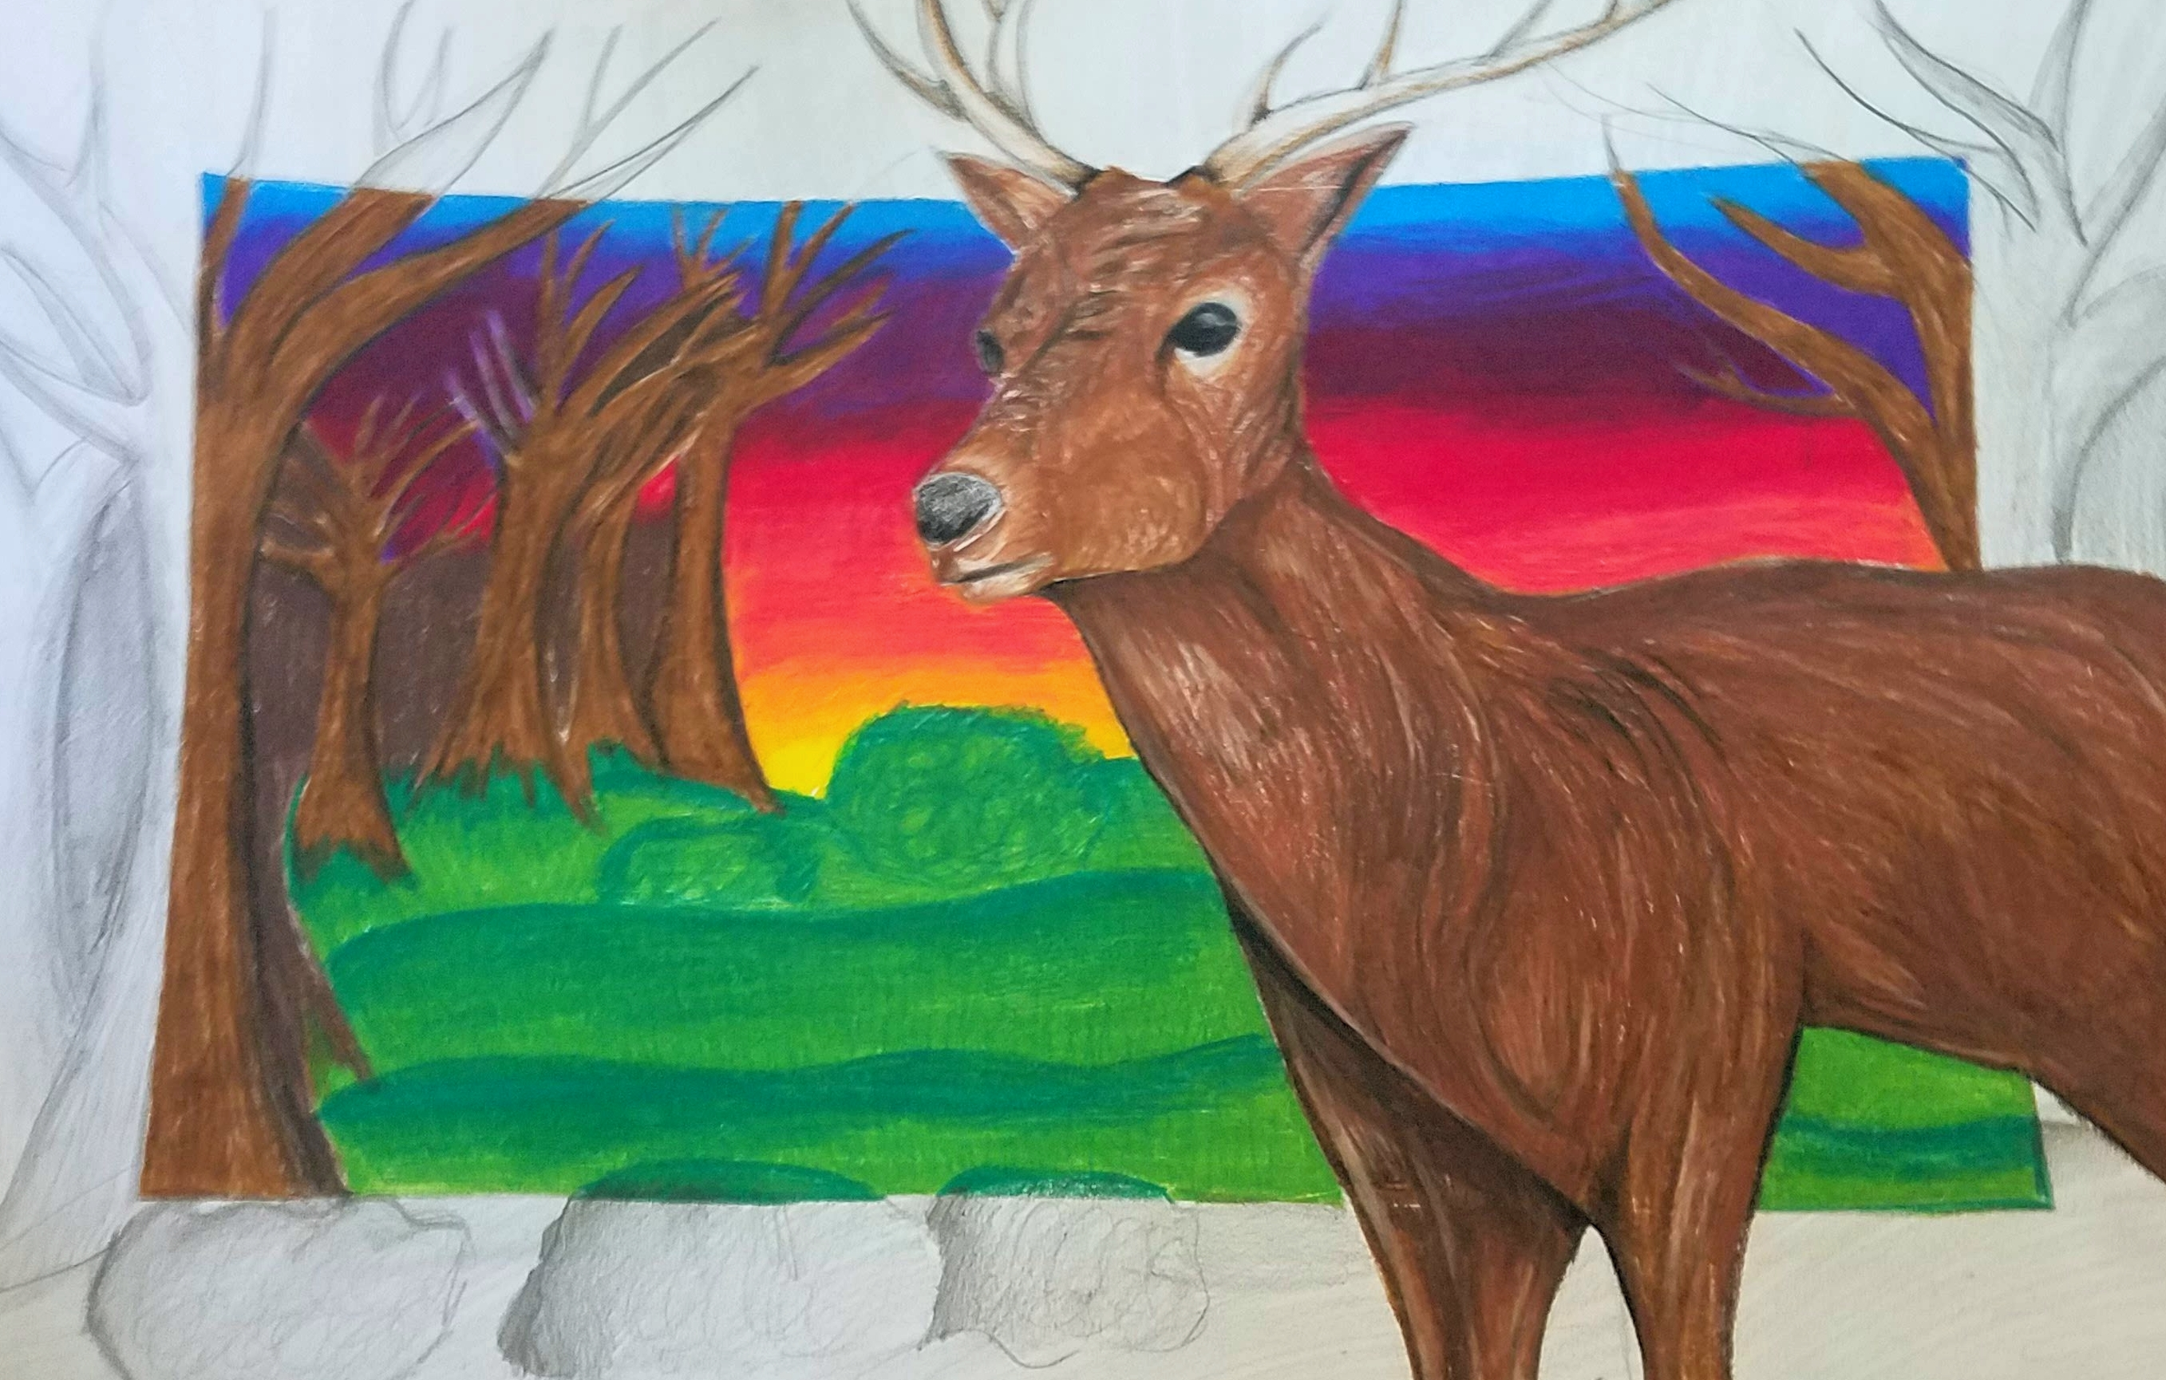
Beyond the Border

Slide 2
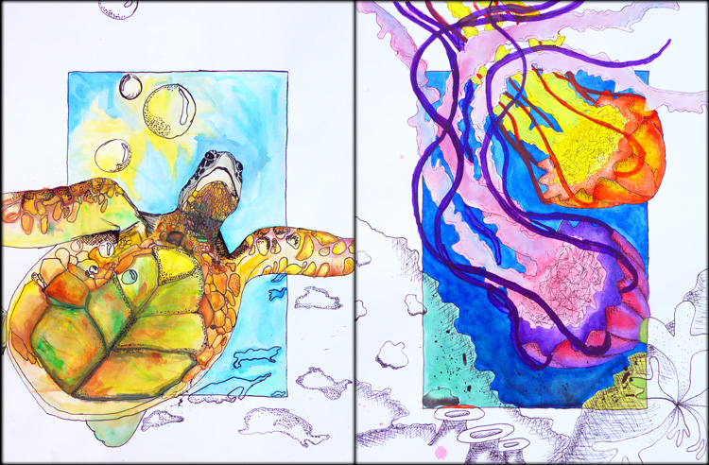
Shading Project- ”BEYOND THE BORDER”

Slide 3
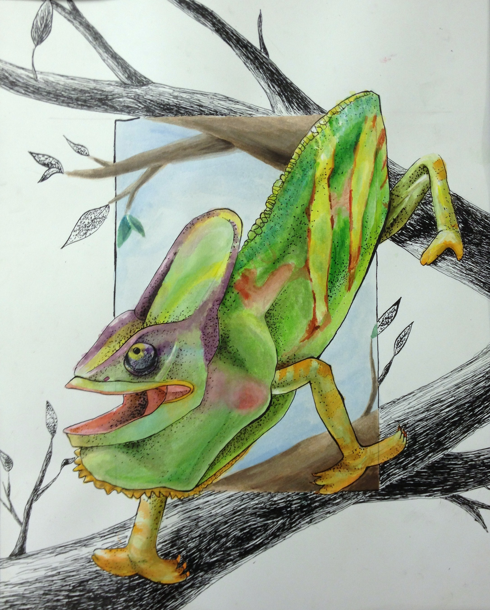
“Beyond the Border” Instructions
Choose 3 animals you may want to draw. You will narrow it down to 1 idea later.
Divide 1 piece of sketchbook paper into thirds.
This doesn’t have to be perfect. This is to help separate your ideas/sketches
You will be sketching one animal composition per section.
On your sheet of paper, create 1 different composition (layout or idea) per section.
You should have 3 DIFFERENT designs on the one piece of paper when you are done.
THIS IS YOUR “SCRATCH WORK” so it does not have to be perfect either
How do you want the animal to FILL the page? Background you wish to include?

Slide 4
“Beyond the Border” Instructions
When you have 3 DIFFERENT ideas, get your sketches checked off and show teacher your favorite.
ONCE DESIGN IS APPROVED, begin sketching your design on the “Final Draft” paper
Once you have it drawn in roughly (It does not have to be finished completely) add your border.
Your border should measure 3 inches in on each side of your paper
Your animal/insect/subject matter must overlap the border line you’ve drawn in order to “Pop out” once colored.
Continue sketching in your subject matter.
Remember: The subject matter should be overlapping the border.

Slide 5
“Beyond the Border” Instructions
GET CHECKED OFF once everything is drawn in
ONCE APPROVED- Begin coloring in animal
ONCE ANIMAL IS COLORED IN- begin coloring in everything INSIDE the border
ONCE EVERYTHING INSIDE BORDER + ANIMAL IS COLORED IN- begin shading everything else.
Continue until project is complete!
HINT- Start with top of paper when shading in with graphite. Work your way down the paper to prevent smudging.

Slide 6
Sketch with Border Animal colored in Animal + everything IN border colored in

