Slide 1
Edward Gorey
Dreams and Nightmares

Slide 2
Who is Edward Gorey?
Born 1925 in Chicago, died in 2000.
Author and Illustrator- Worked with “Pen and Ink” to create dark, drawings to go with his offbeat tales.

Slide 3
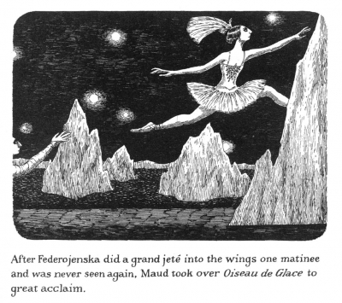

Slide 4
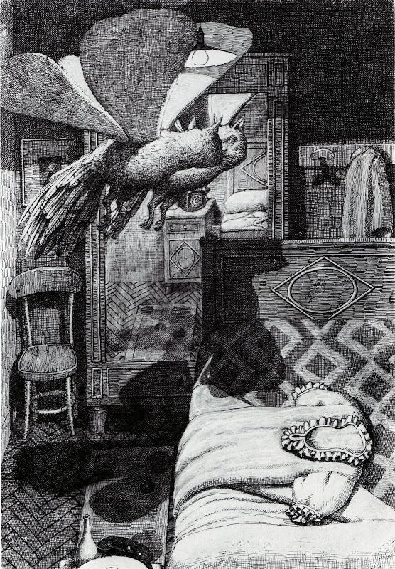

Slide 5
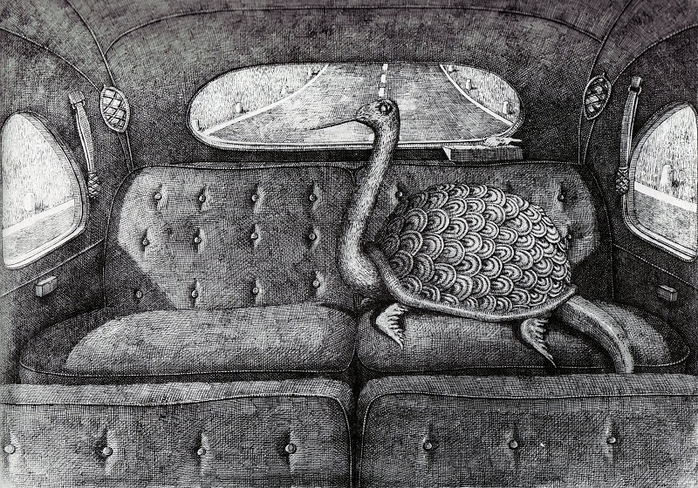

Slide 6
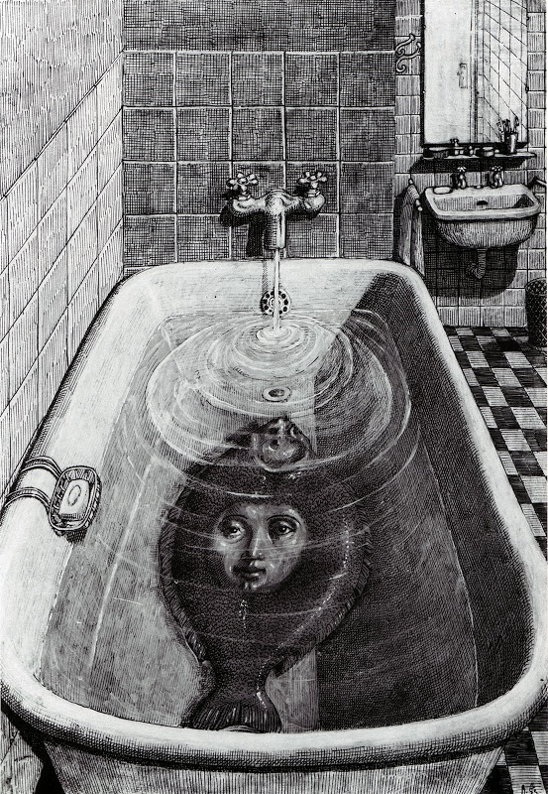

Slide 7
What are some features that all of his work share?

Slide 8
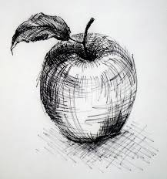
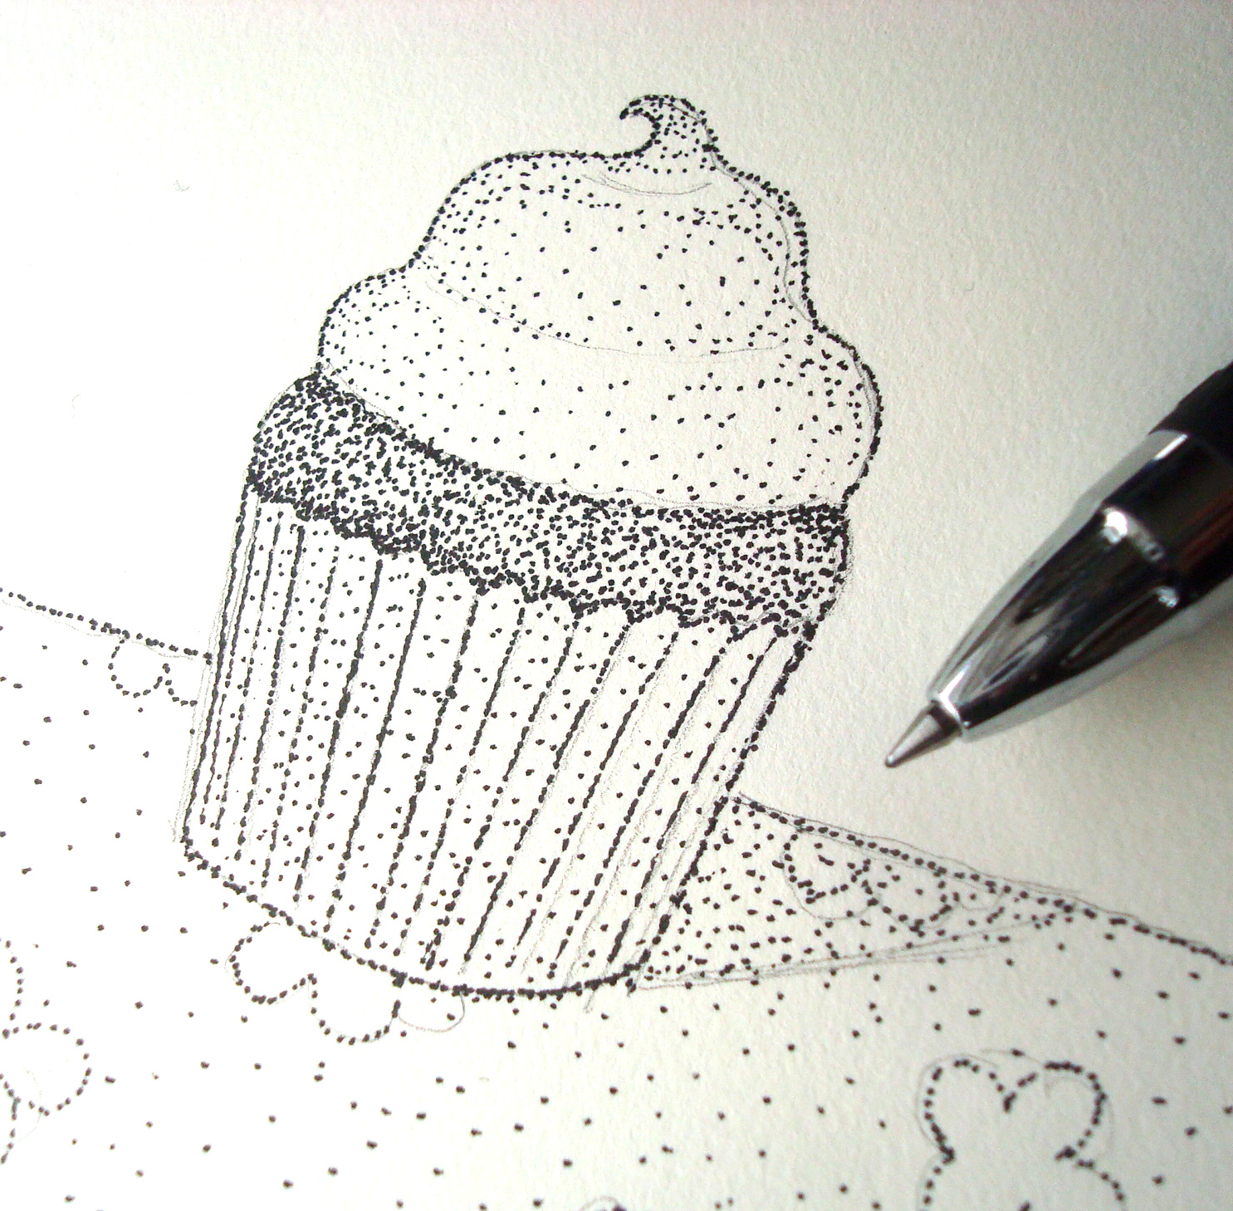
What are some features that all of his work share?
Range of Values
Implied Texture
Whimsical Combinations of Objects
Crosshatching and Stippling

Slide 9
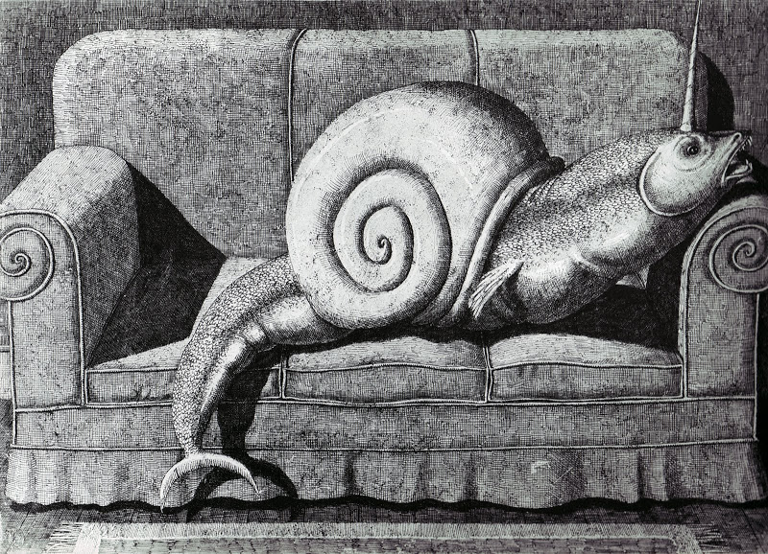

Slide 10
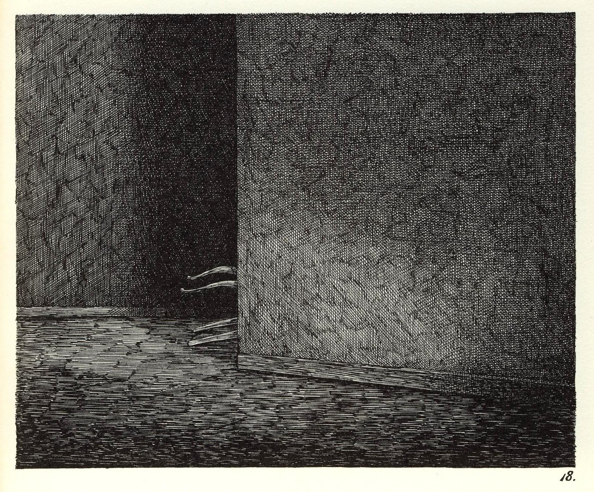
https://www.youtube.com/watch?v=8XxVhPuUza0

Slide 11
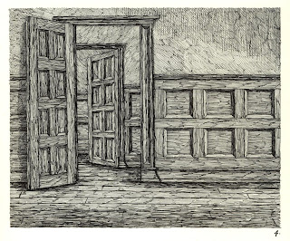

Slide 12
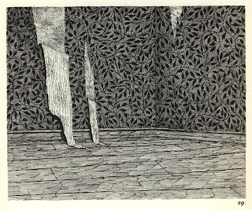

Slide 13
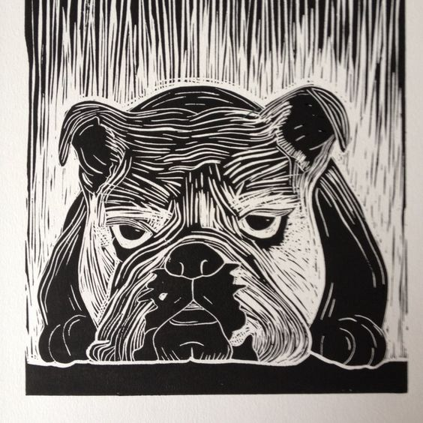

Slide 14
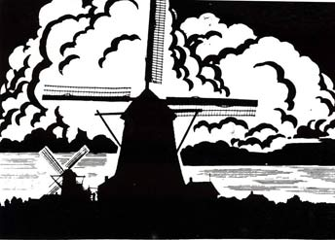
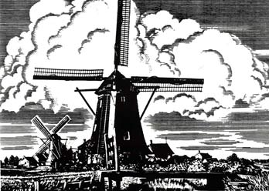
STEPS:
Complete worksheet
(After approval) Enlarge BEST design on 8 ½ x 11 but SIMPLIFY
Transfer to scratchboard
Find areas that need to be the lightest and scratch off those areas FIRST, then work on areas with increasingly dark values.

Slide 15
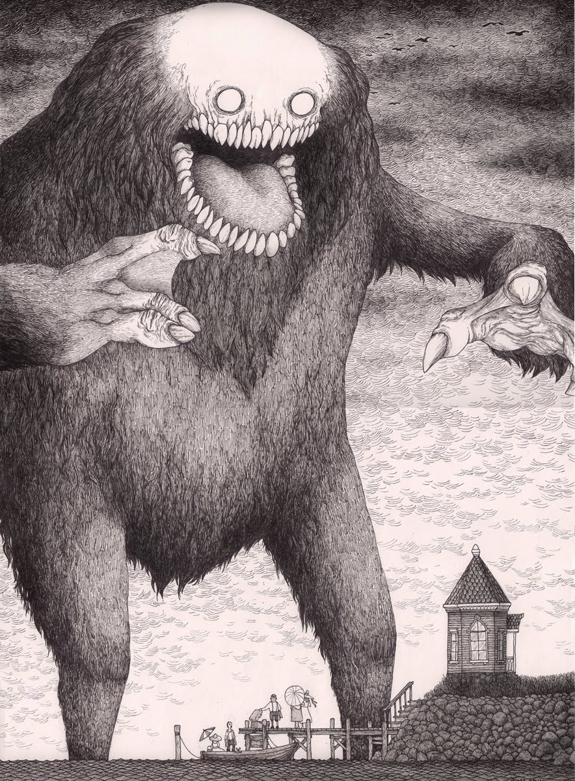

Slide 16
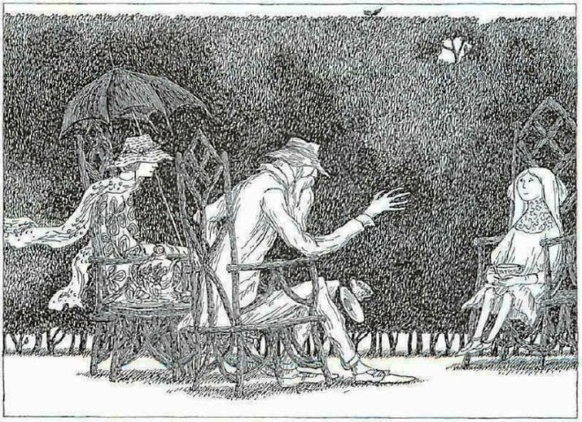

Slide 17
What We Will Be Doing…
STEPS TO FOLLOW:
Take some time to describe at least three previous dreams you have had on the handout given to you.
Next, underline all the descriptive nouns within your paragraphs.
Then you will get photographic images of your descriptive nouns from online and copy them to a one-page word document.
You will print out this one page and use the images you printed to create 3 thumbnail sketches using your dreams as your subject matter.
Then Mrs. Harper will help you to look over and pick the best sketch to create for your larger composition.
Then you will draw your best idea onto the 9x12 paper in pencil.
Finally, you will use an ebony pencil to transfer design to scratchboard.
Create a list of

