Slide 1
Elements and Principles Of Design

Slide 4
How To:
Start with drawing paper laid out Horizontally.
Measure length of paper, then divide number by 2. Make a mark here.
Draw lines from bottom right corner and bottom left corner up to this mark. Turn paper upside down and repeat.
Flip paper and repeat steps so that both sides (front and back) line up. Write Vocab on back.

Slide 5
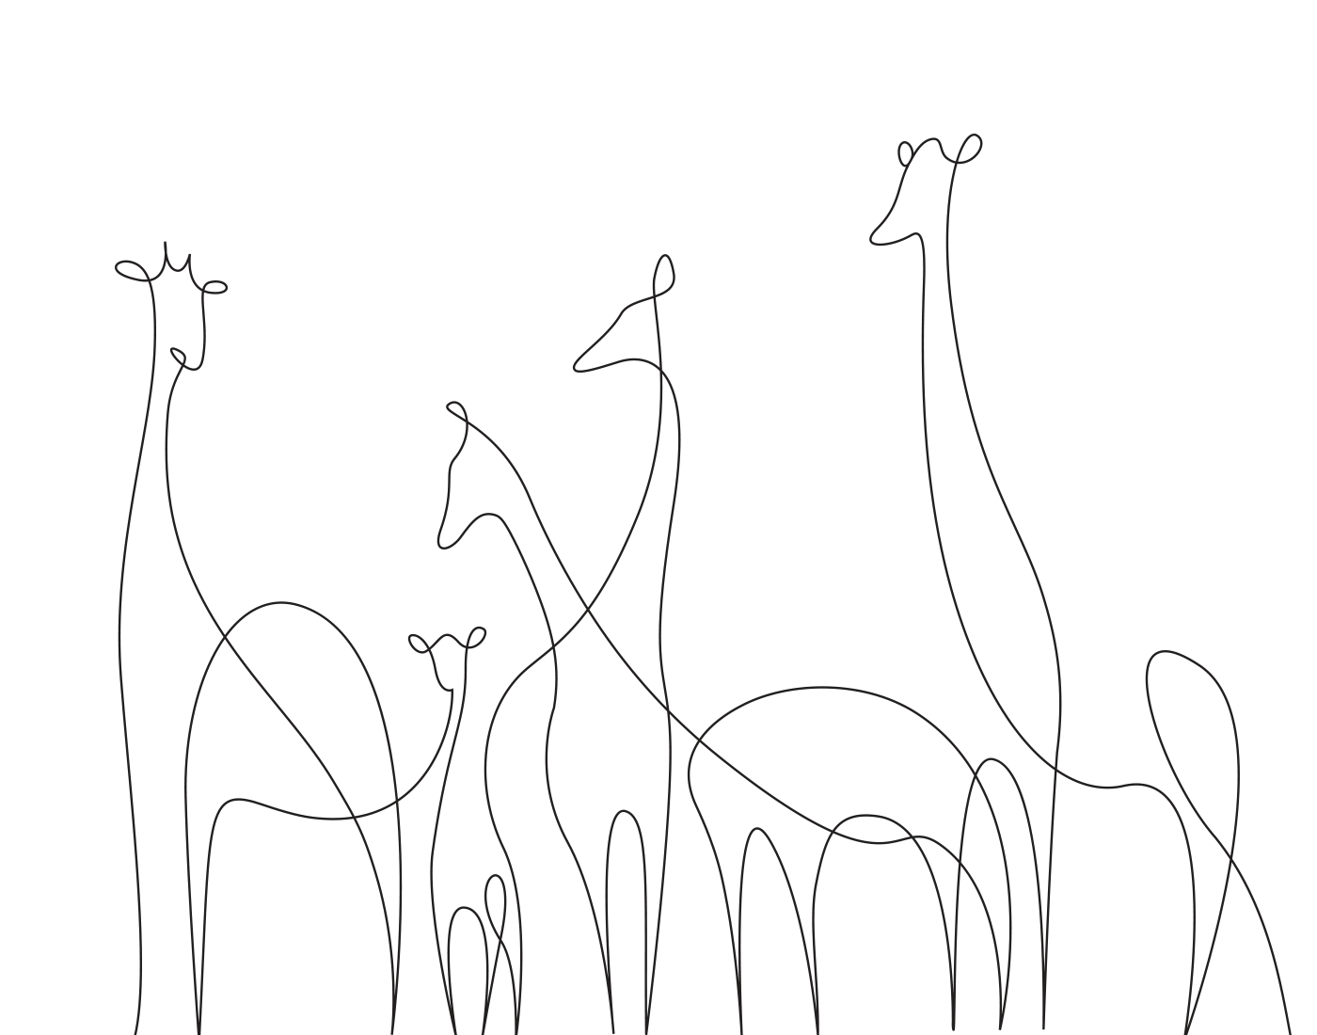
Line
An element of art defined by a point moving in space. Line may be two-or three-dimensional, descriptive, implied, or abstract.

Slide 6
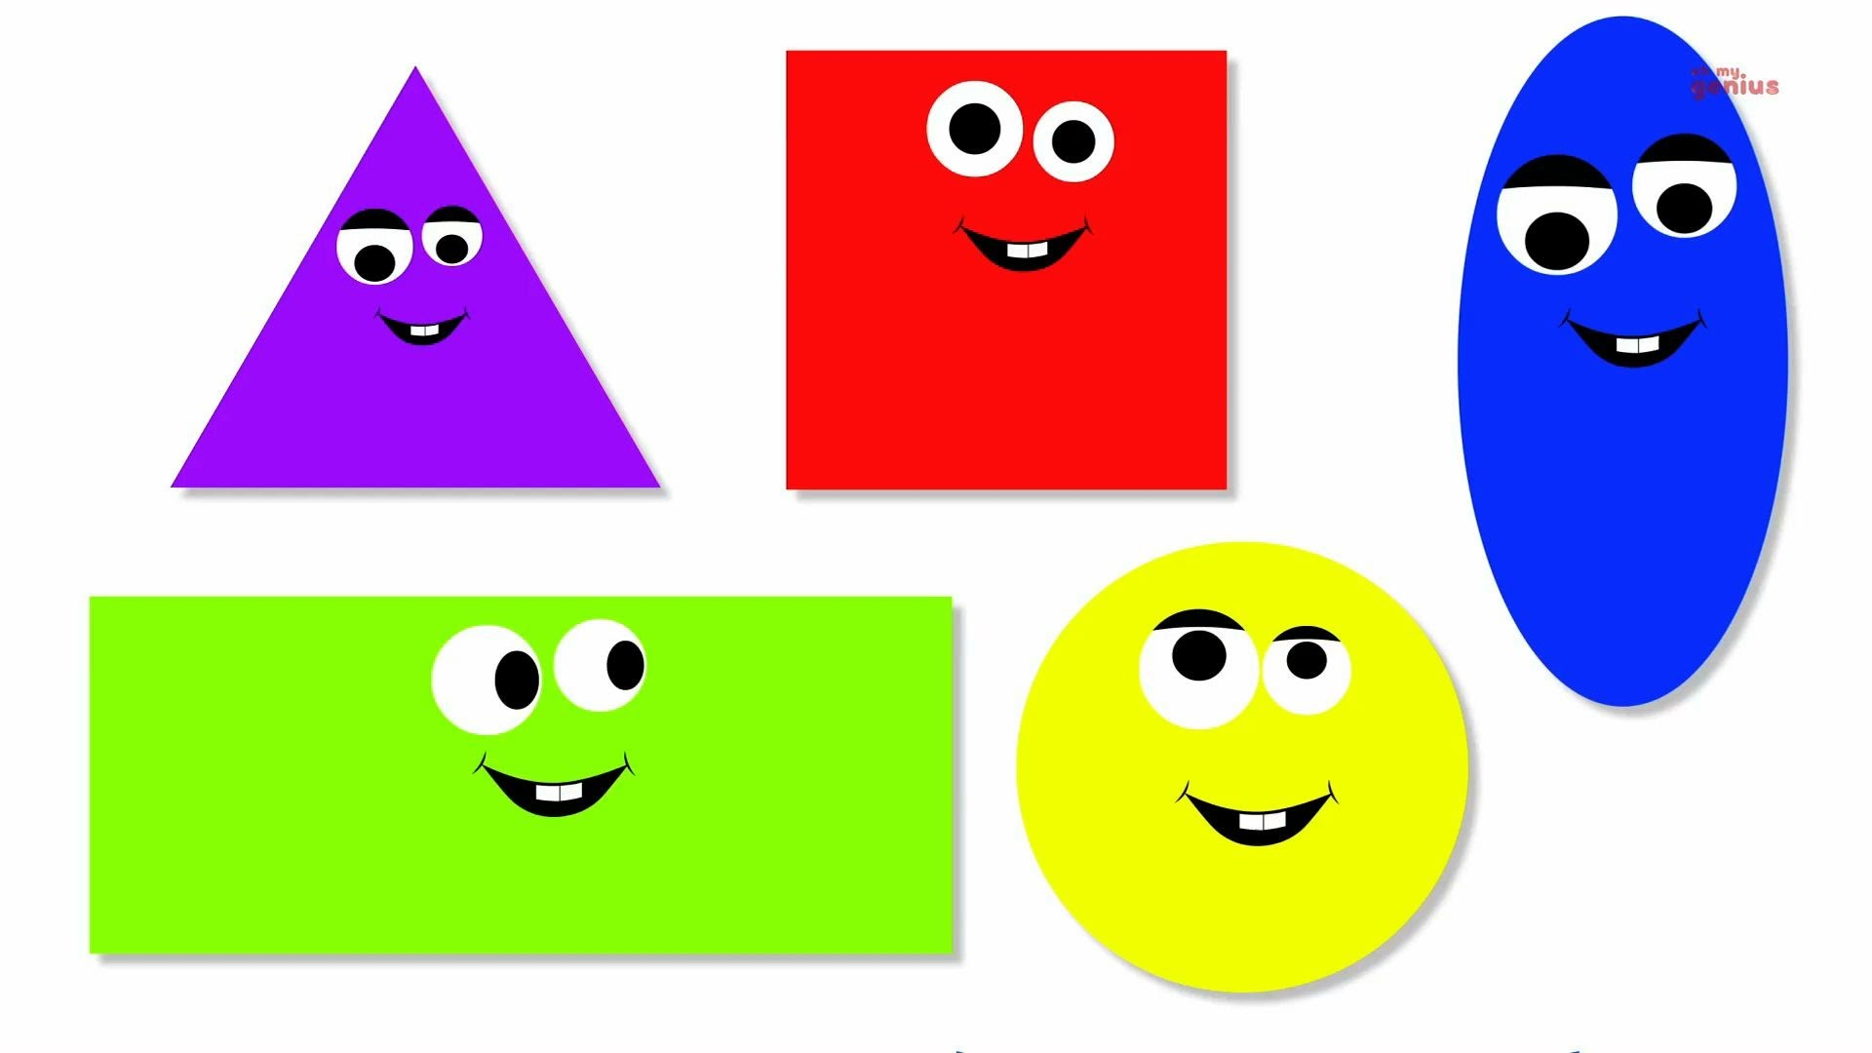
Shape
An element of art that is two-dimensional, flat, or limited to height and width

Slide 7
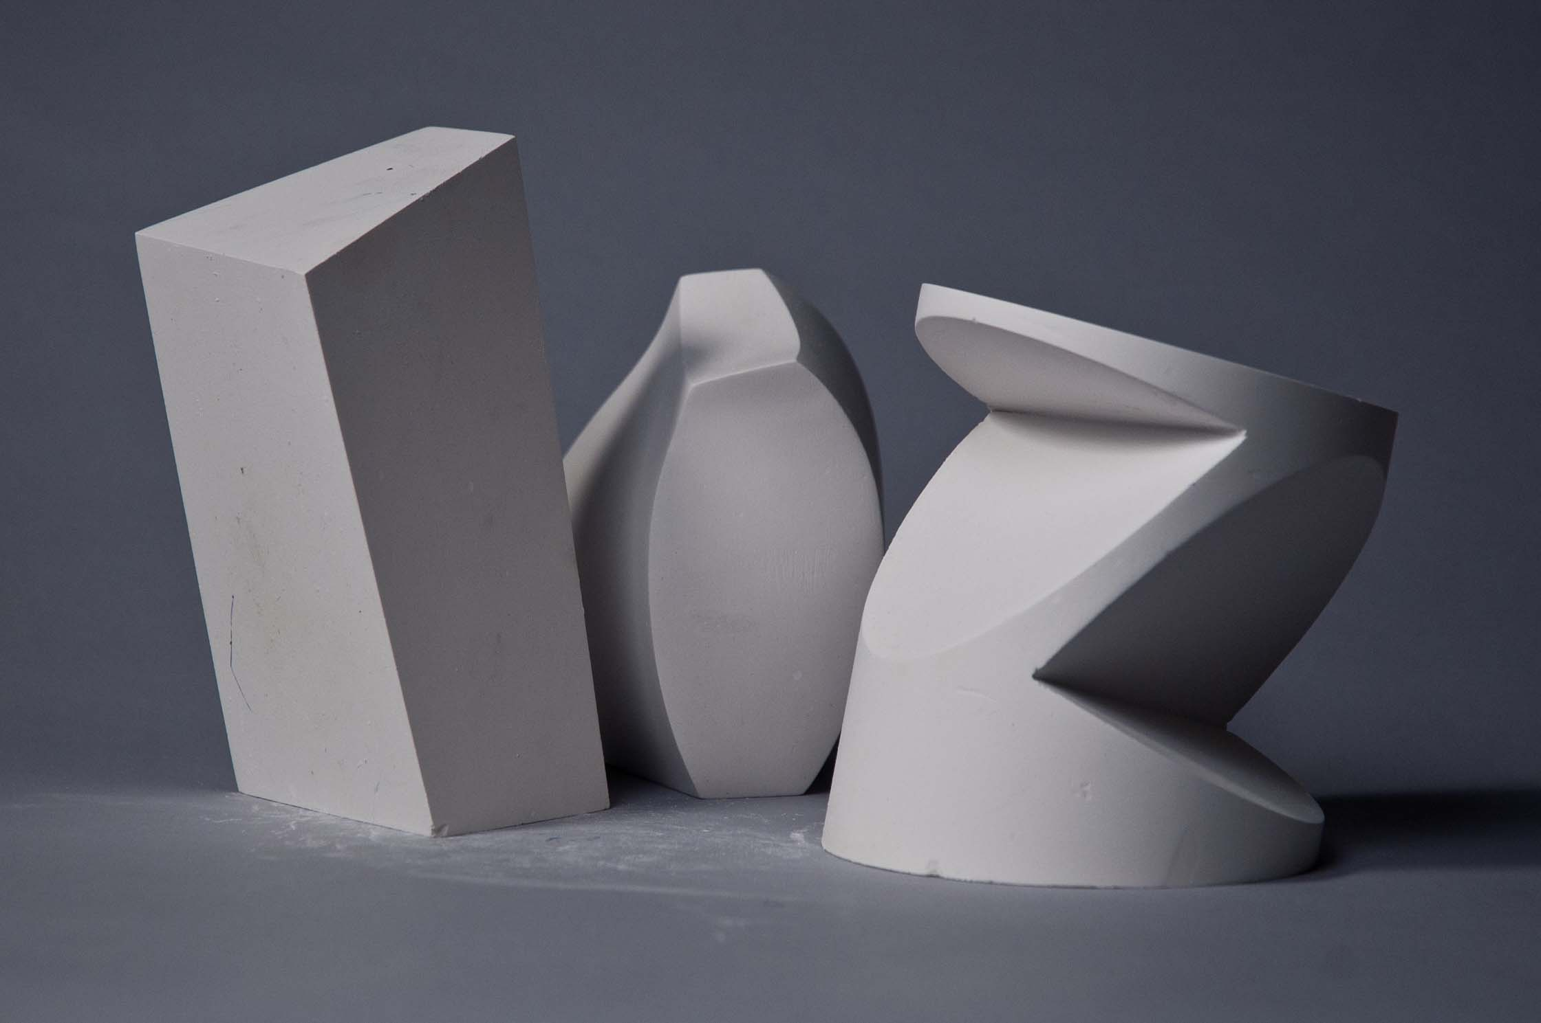
Form
An element of art that is three-dimensional and encloses volume; includes height, width AND depth

Slide 8
Value
The lightness or darkness of tones or colors. White is the lightest value; black is the darkest.

Slide 9
Space
An element of art by which positive and negative areas are defined or a sense of depth achieved in a work of art

Slide 10
Color
An element of art made up of three properties: hue, value, and intensity.
Hue: name of color
Value: hue’s lightness and darkness (a color’s value
changes when white or black is added)
Intensity: quality of brightness and purity (high
intensity= color is strong and bright; low intensity= color is faint and dull)

Slide 11
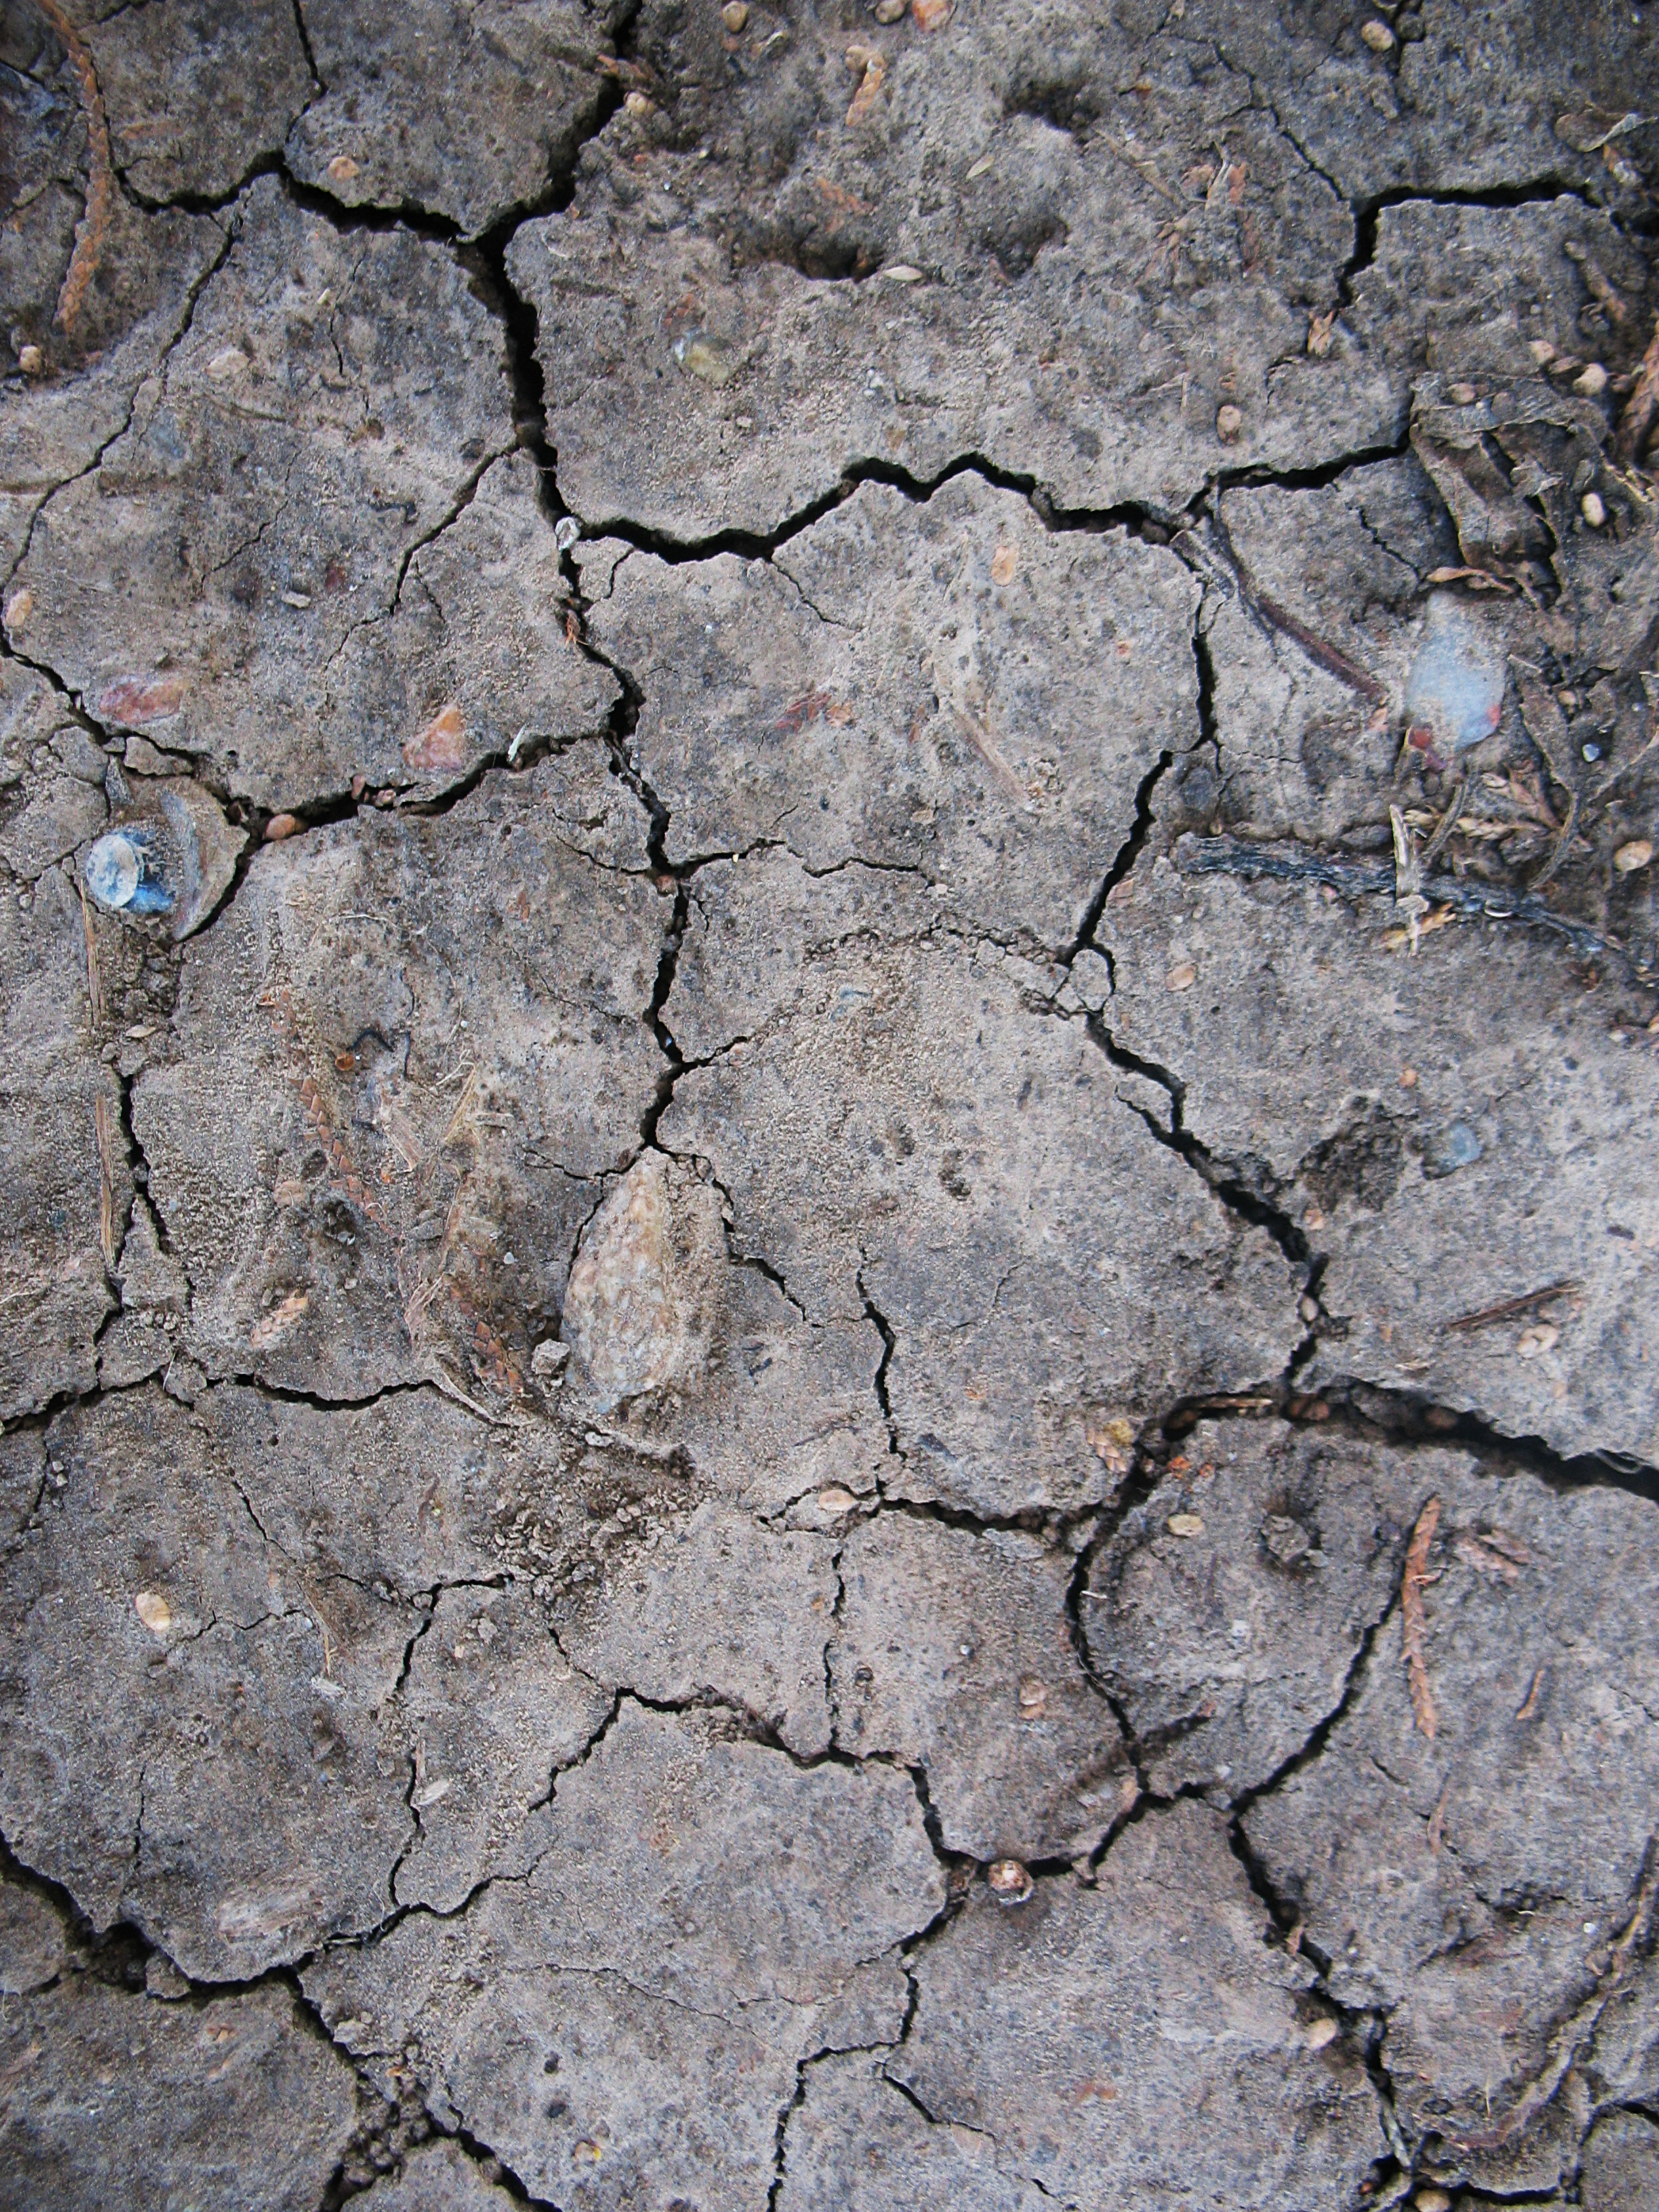
Texture
An element of art that refers to the way things feel, or look as if they might feel if touched.

