Slide 1
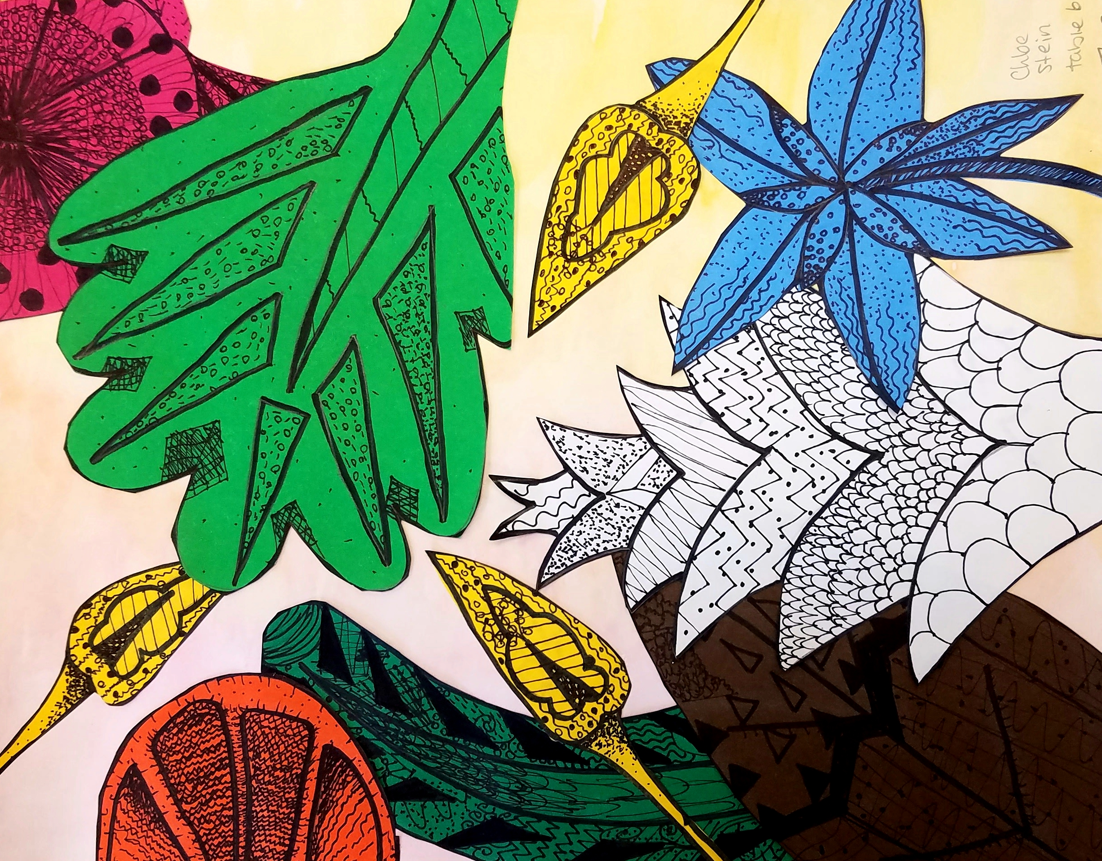
Exotic Environments
Using Line to Create Value

Slide 4
What is Value?
Value is the range of light to dark

Slide 5
How can an artist use lines to show value?

Slide 8
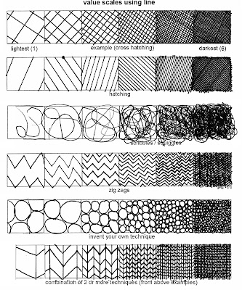

Slide 9
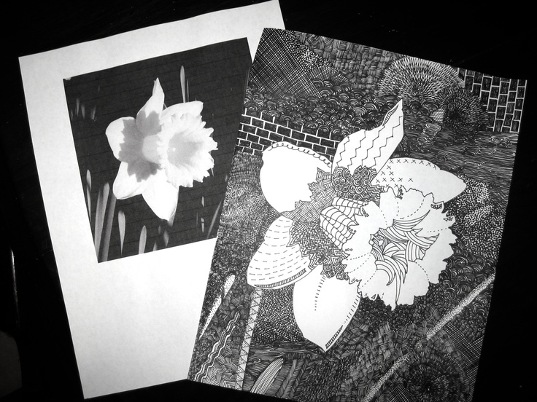

Slide 10
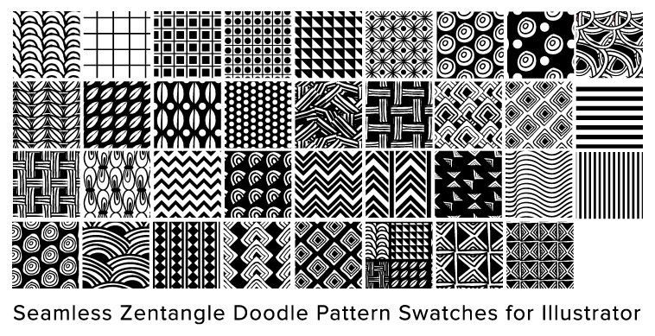

Slide 11
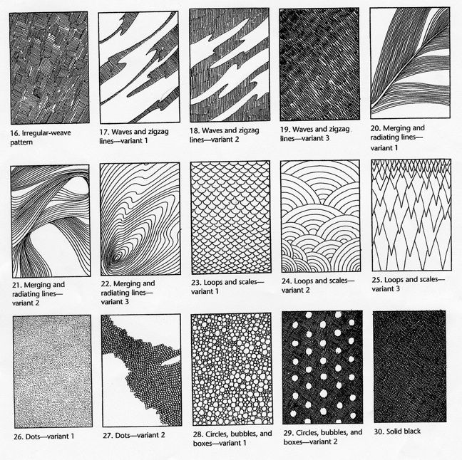

Slide 12
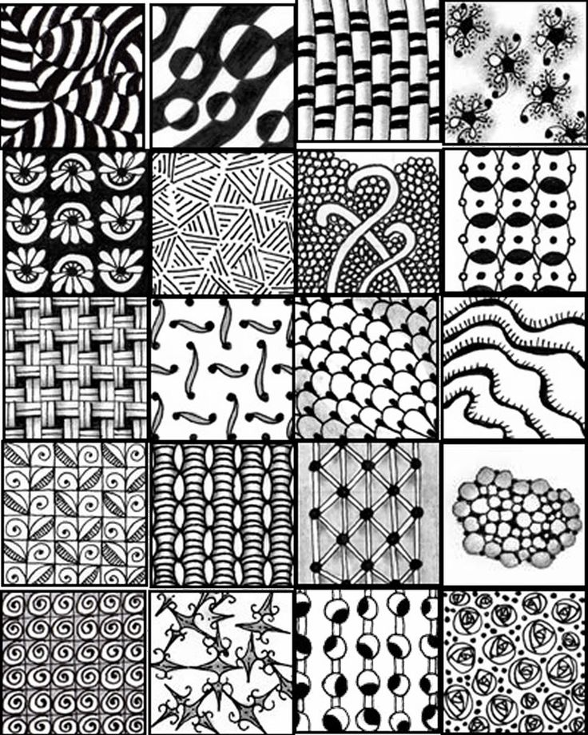

Slide 13
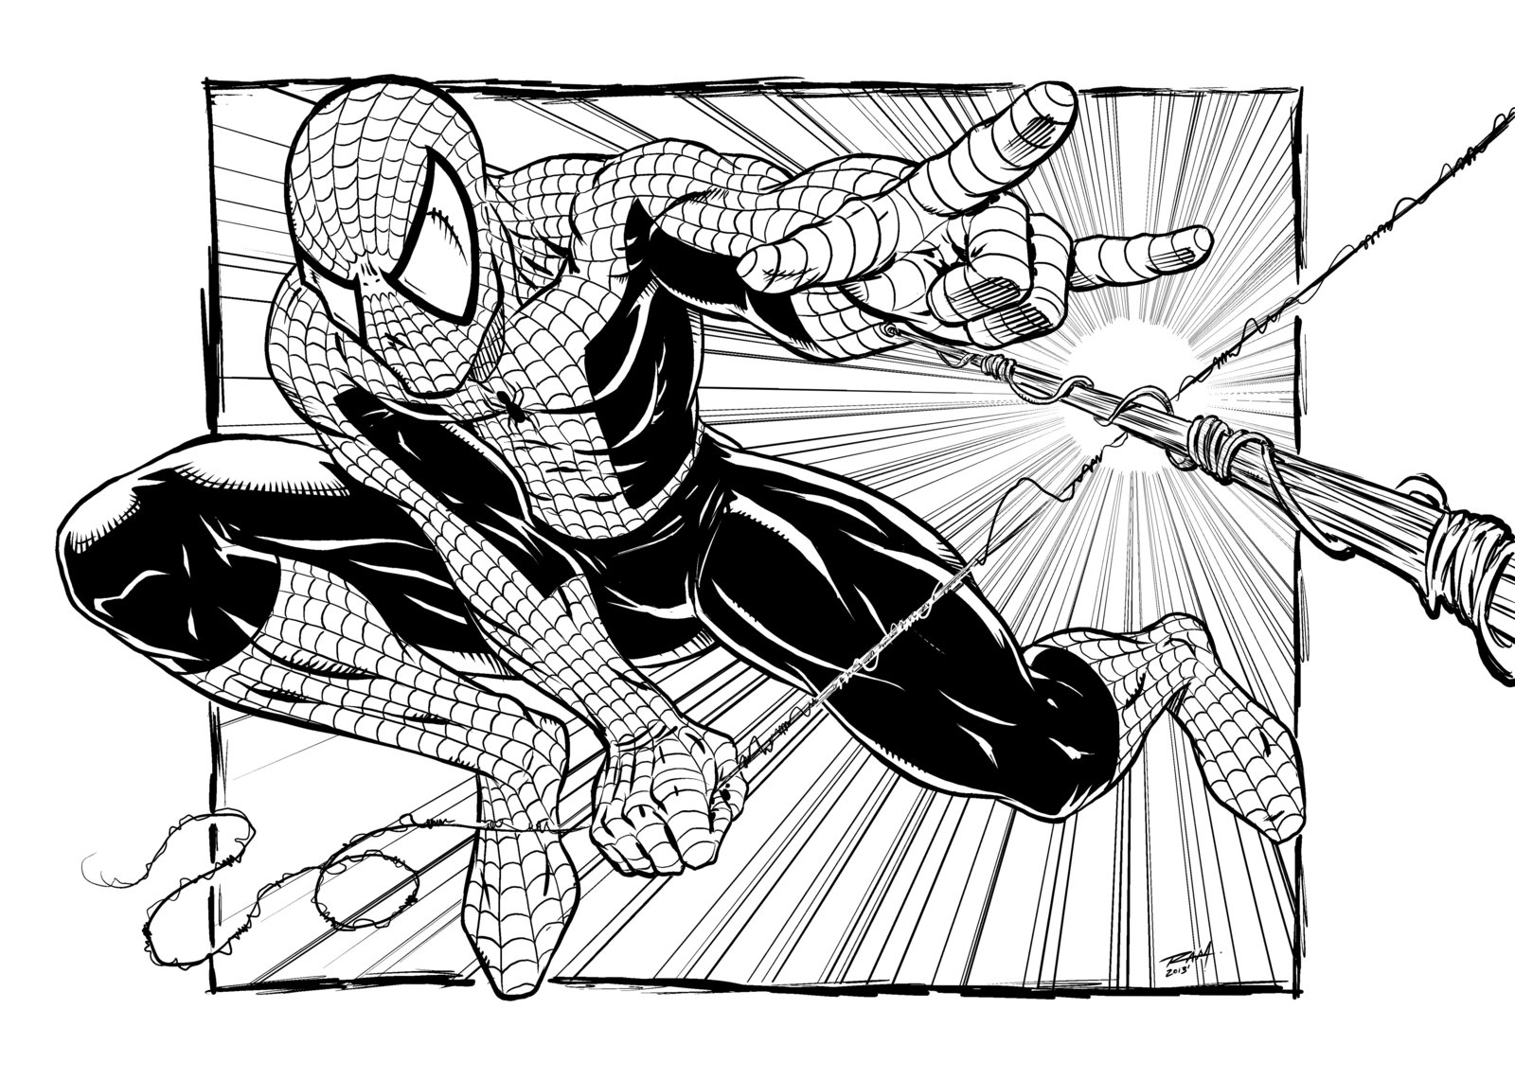

Slide 14
What You Will Be Doing:
Day 1: Practice creating Value! Complete the handout- Create value scales with values using different patterns, textures, and markings
Day 2: Look through magazines and draw 8- 10 different leaves. PICTURES MUST HAVE DETAIL. Only use LARGE photos.
Day 3: Pick favorite 7 and draw leaves/flowers to fill each ½ sheet of paper. MUST FILL PAGE. Each should be a different value.
Day 4: Create Watercolor wash on background. While paper is drying, cut out each leave/ flower and try different compositions.

Slide 15
What You Will Be Doing:
Day 1: Practice Value! Create value scales with 6 values using different patterns, textures, and markings

Slide 16
What You Will Be Doing:
Day 2: Look through magazines and draw 7 different leaves. PICTURES MUST HAVE DETAIL. Only use LARGE photos.

Slide 17
What You Will Be Doing:
Day 3: Pick favorite 5 and draw leaves/flowers to fill each ½ sheet of paper. MUST FILL PAGE.

Slide 18
What You Will Be Doing:
Day 4: DEMO WATER COLOR
Pick Color Scheme:
If most of your flowers/leaves are WARM (Red, Orange, Yellow), paint a COOL background (Blue, Green, Purple).
If most of your flowers/leaves are COOL background (Blue, Green, Purple), paint a WARM (Red, Orange, Yellow) background.

Slide 19
What You Will Be Doing:
Day 4 Continued:
Create Watercolor wash on background. While paper is drying, cut out each leave/ flower and try different compositions.
Arrangement Must:
Alternate colors (2 Blues should not be right next to each other)
Extend off the page on EACH side (ALL 4)
Overlap in at least 1 place
MUST NOT BE FLOATING (Give everything stems)

