Slide 1
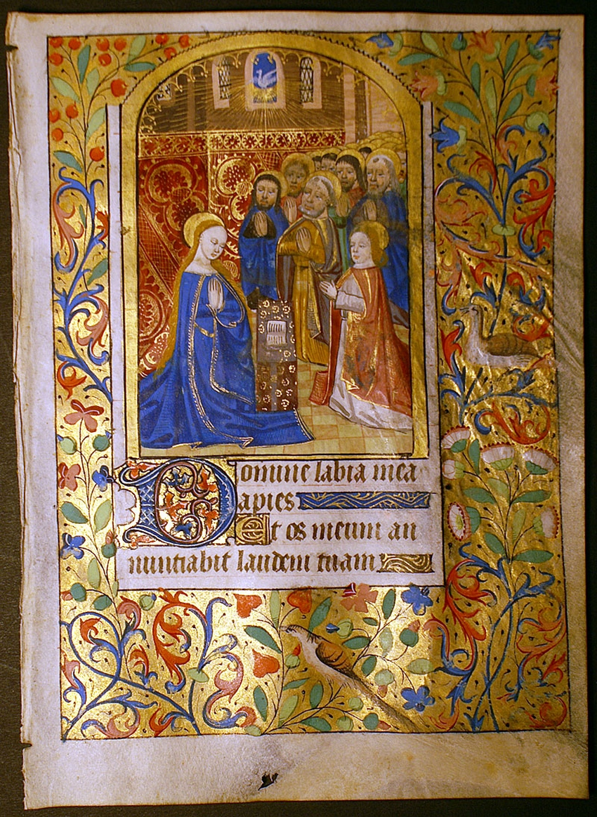
Illuminated Manuscripts

Slide 2
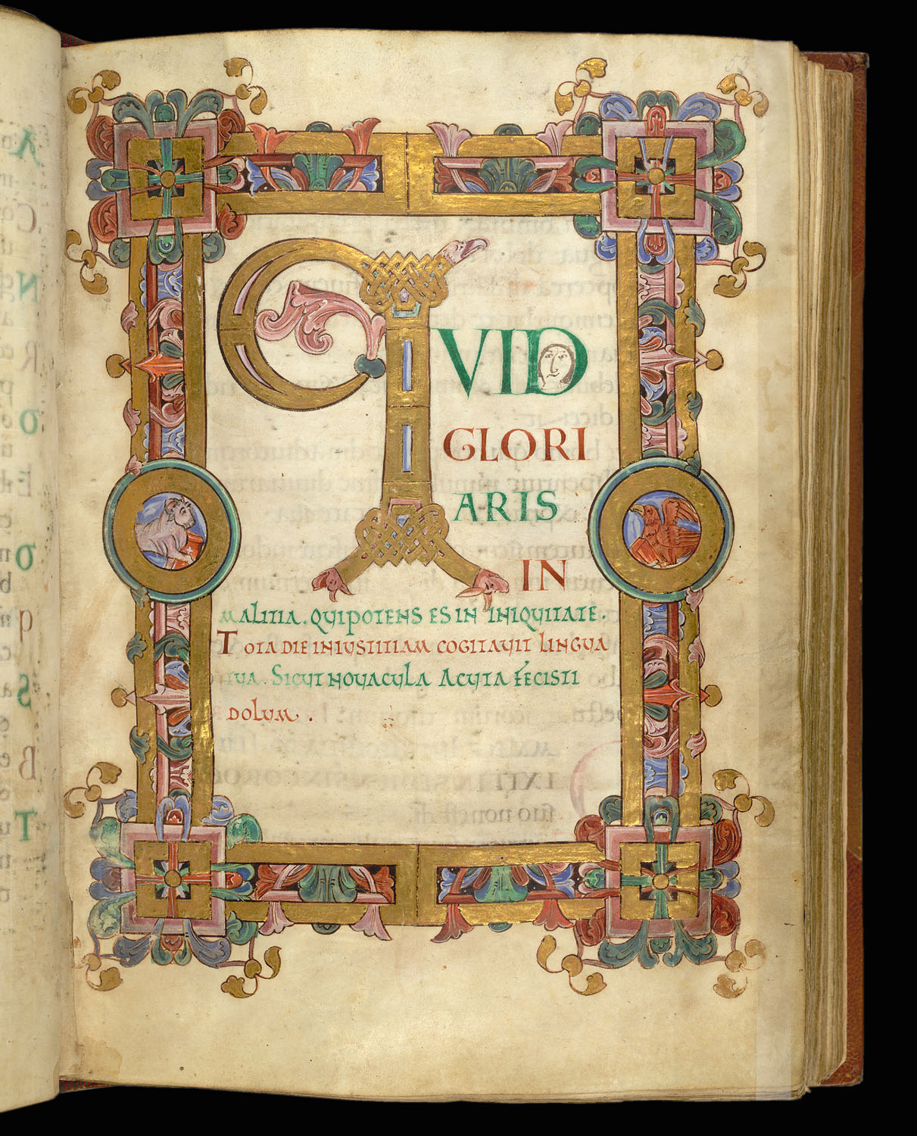
So What Is One?
In the Middle Ages all books were hand-written original works of art. These “illuminated” manuscripts were so called because of their frequent incorporation of gold or sometimes silver leaf onto the page. Illumination comes from the Latin word illuminare, meaning “light up,” and when one sees one of these brilliant manuscripts in person, the term makes sense.

Slide 3
So What Is One?
The earliest surviving illuminated manuscripts date from the 5th century, though it was not until about 1100 that the production of manuscripts began to flourish in earnest. This “golden age” of manuscript illumination lasted until the arrival of Gutenberg’s printing press in 1450-55, signaling the beginning of the end of hand-made illuminated manuscripts.

Slide 7
What YOU will be doing:
Brainstorm ideas in sketchbook!
List AND Draw 10 patterns/symbols that represent YOU.
Decide on Letter. Will you use your first or last initial???
Pick font (Style of lettering) and practice! (Examples in handout)

