Slide 1
Literal Word Art

Slide 2
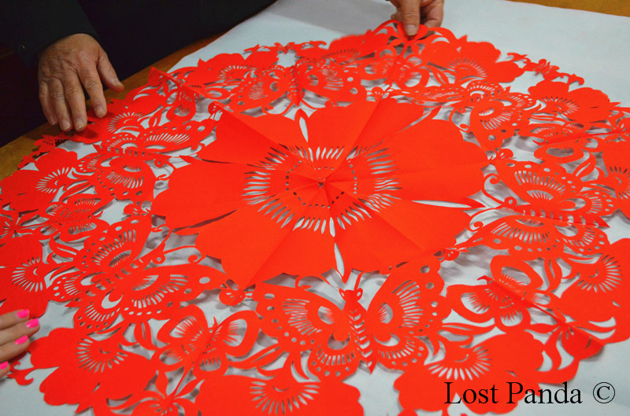
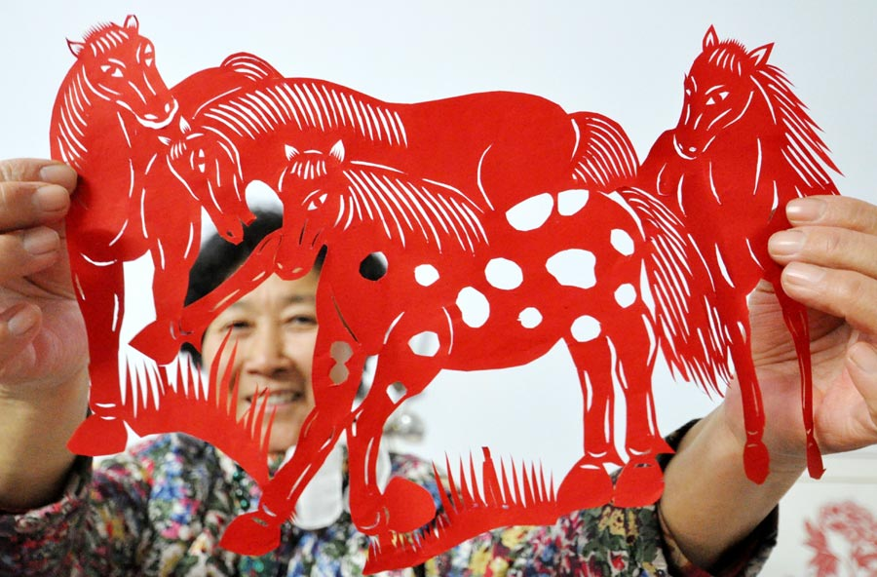
History of Papercutting
Paper cut art appeared during the Han Dynasty around 400 AD after paper was invented.
Although the process is popular in many European countries, the knowledge of paper making did not reach Europe until the 1300’s so papercutting could only have arrived after that.

Slide 3
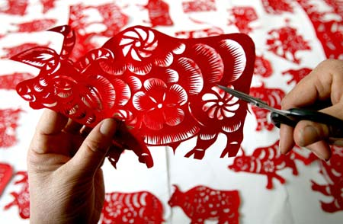
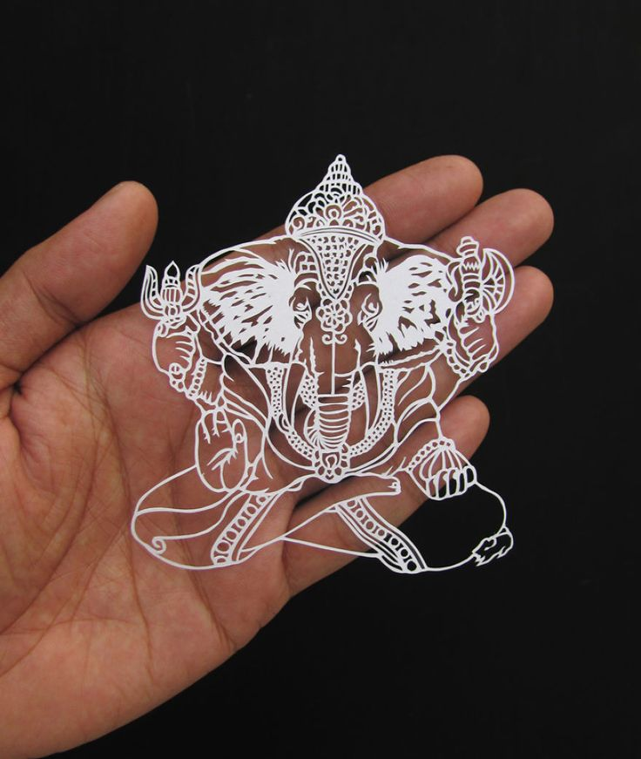

Slide 4
Where Else Have We Seen Paper Cuttings?

Slide 5
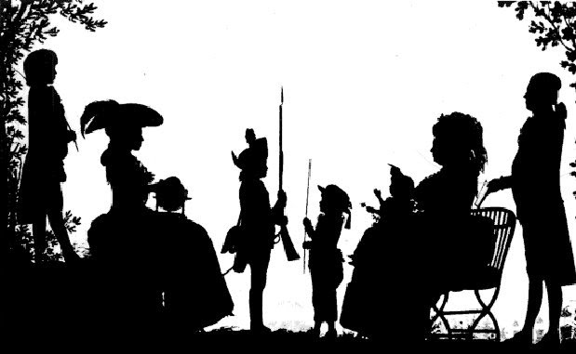
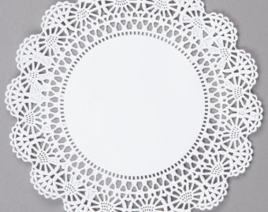
Where Else Have We Seen Paper Cuttings?

Slide 6
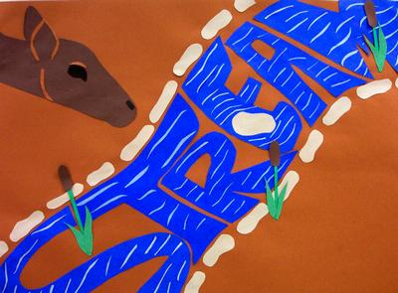
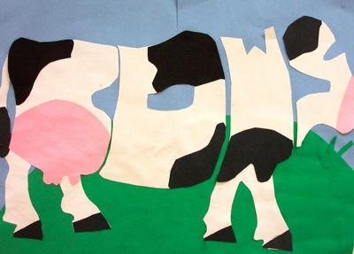

Slide 7
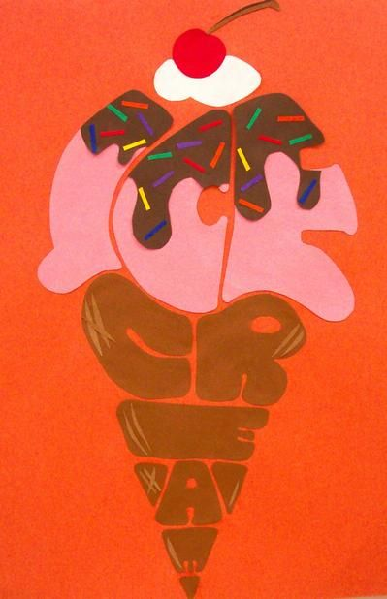
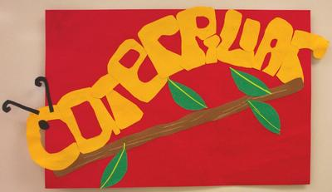

Slide 8
What you will be doing:
Divide page into 1/4ths
Choose 4 different words and draw (and color) them in the shape of the word they represent
Helpful Hints:
Think about how different colors might make your work stronger.
Start by drawing the basic shape, then fill with the word using “bubble letters”. This will help you fill the space.

Slide 9
