Slide 1
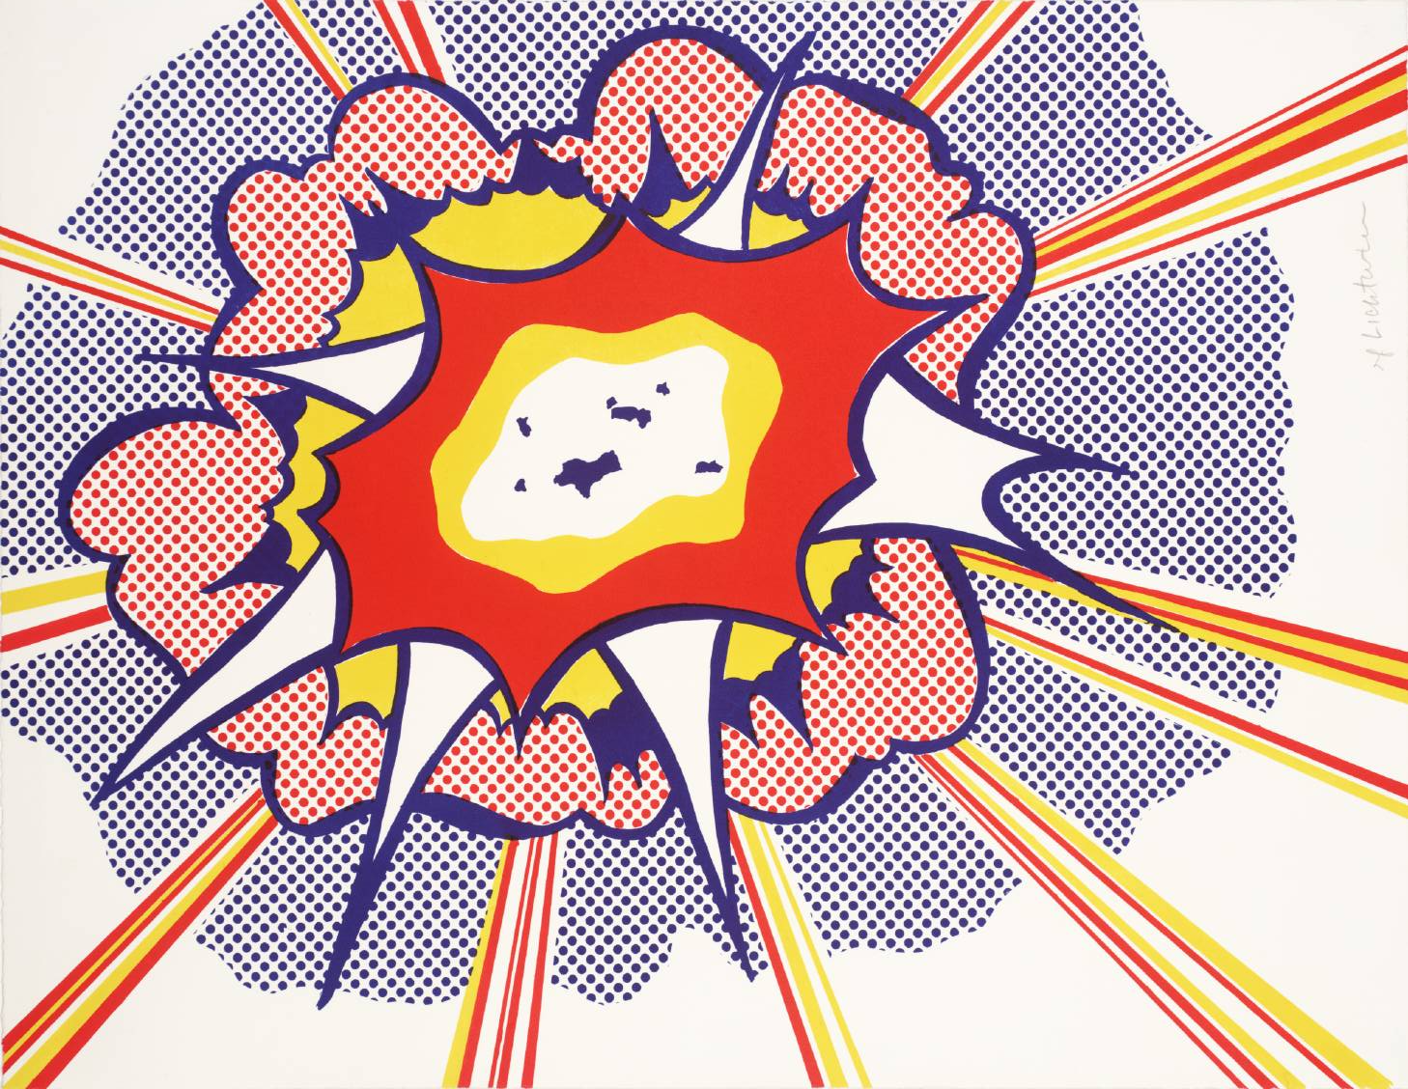
Roy Lichtenstein Onomatopoeia Art!

Slide 2
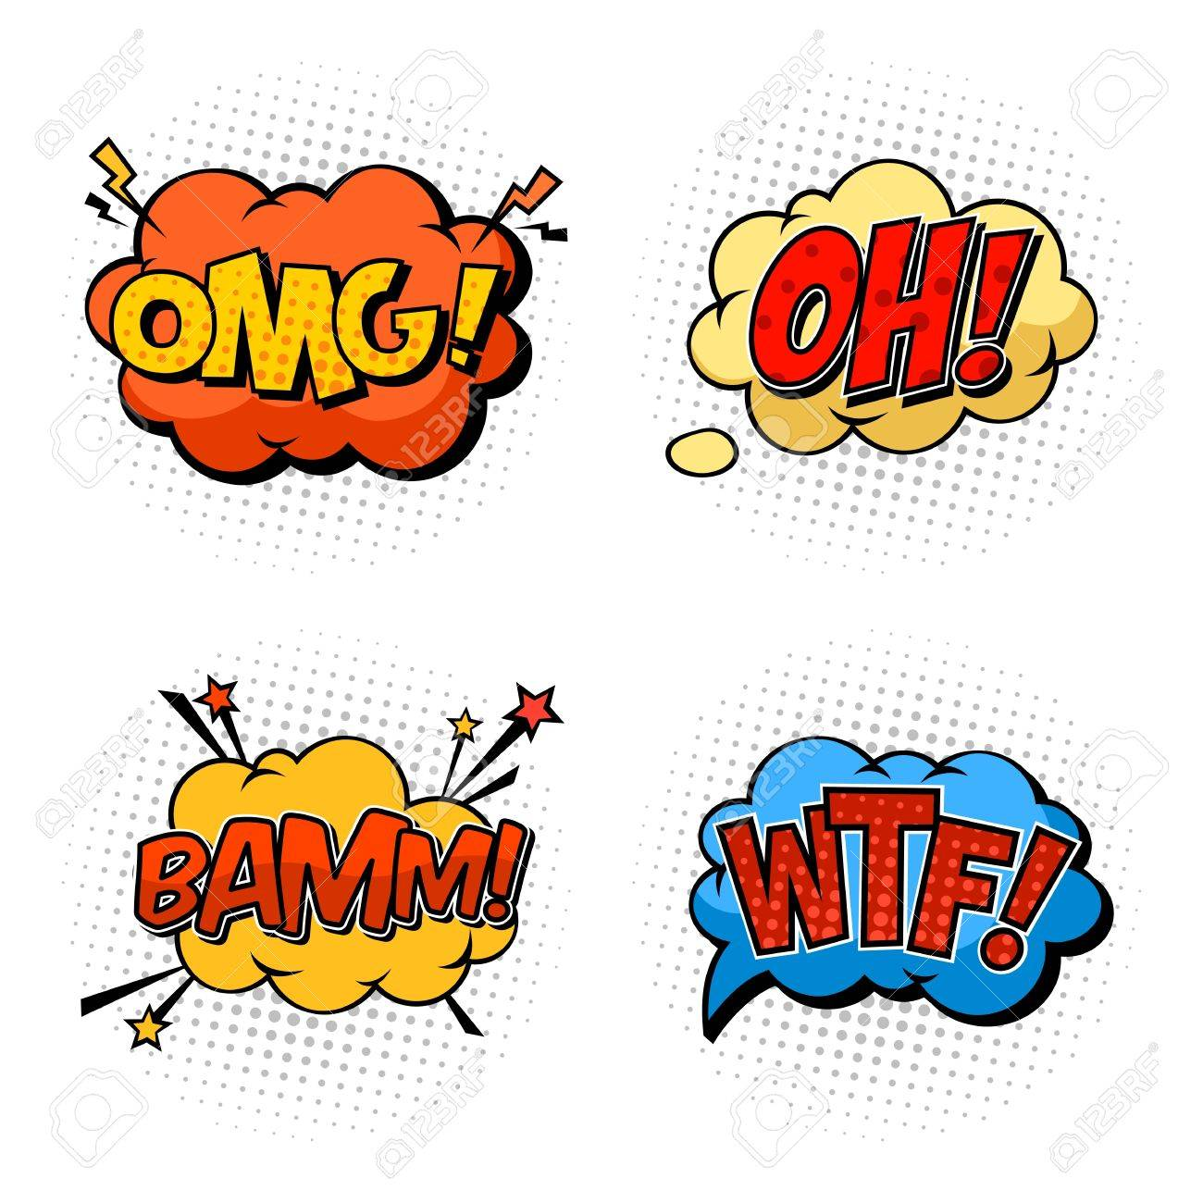
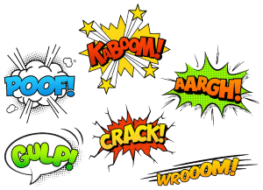
What is an Onomatopoeia???
the formation of a word from a sound associated with what is named (e.g. cuckoo, sizzle ).

Slide 3
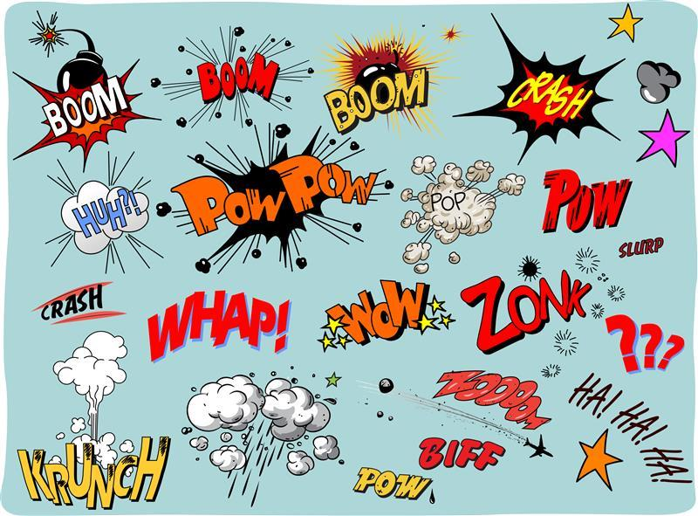

Slide 4
What is Pop Art???
Art based on modern popular culture and the mass media, especially as a critical or ironic comment on traditional fine art values.

Slide 5
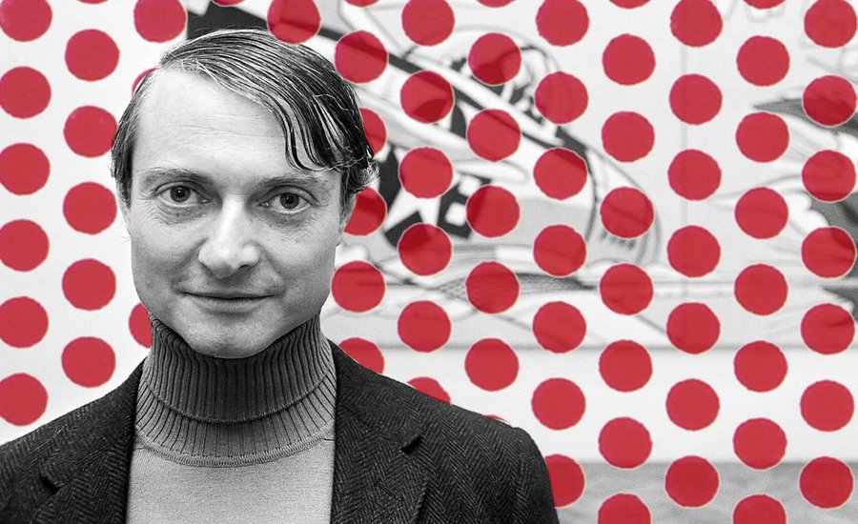
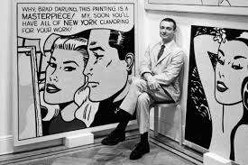
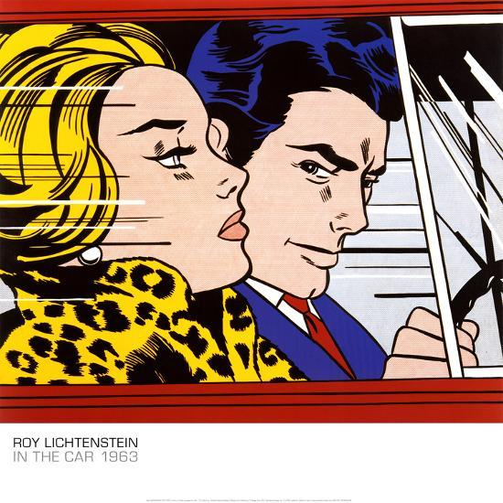
Who is Roy Lichtenstein???
Roy Fox Lichtenstein was an American pop artist. During the 1960s, along with Andy Warhol, among others, he became a leading figure in the new art movement. His work defined the premise of pop art through parody.

Slide 6
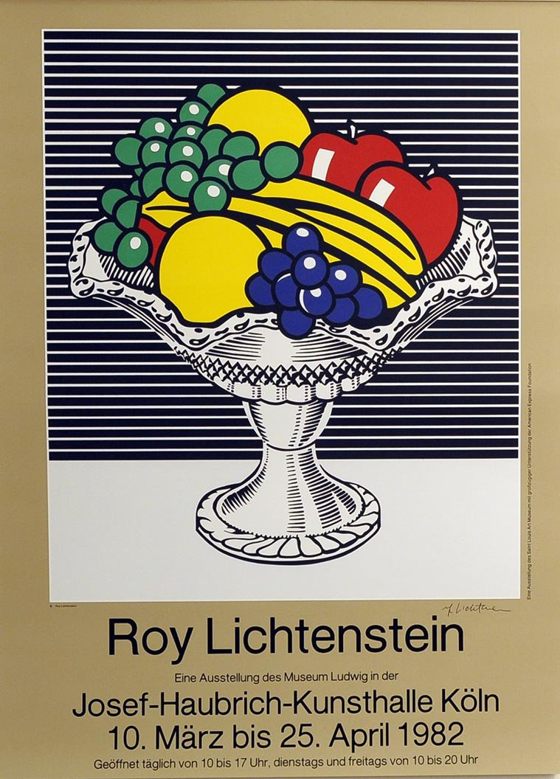
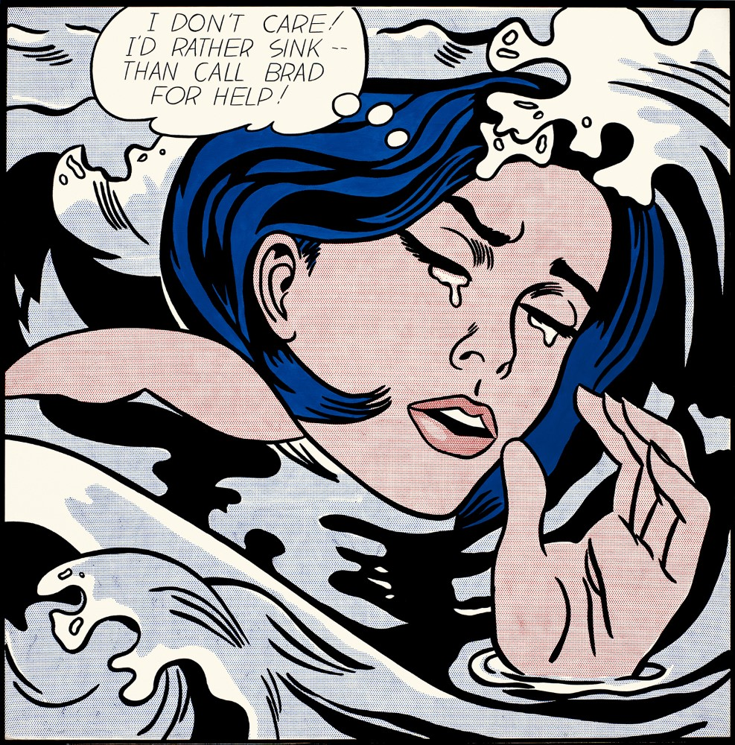

Slide 7
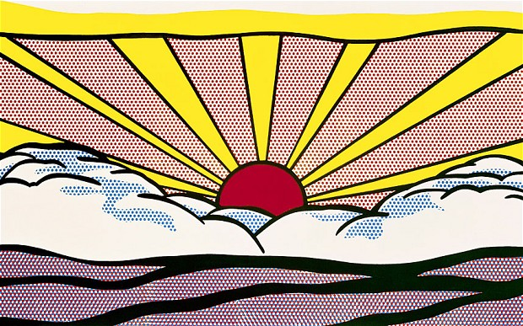
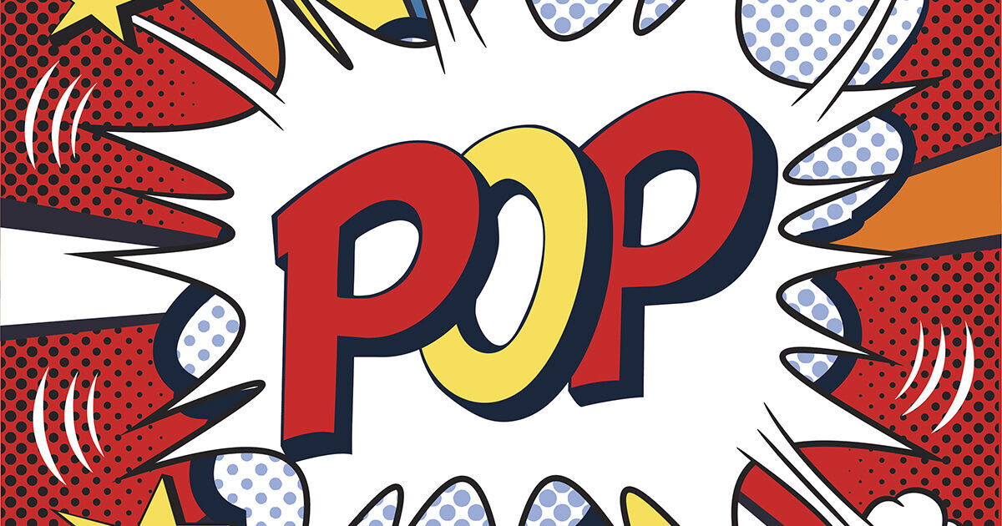

Slide 8
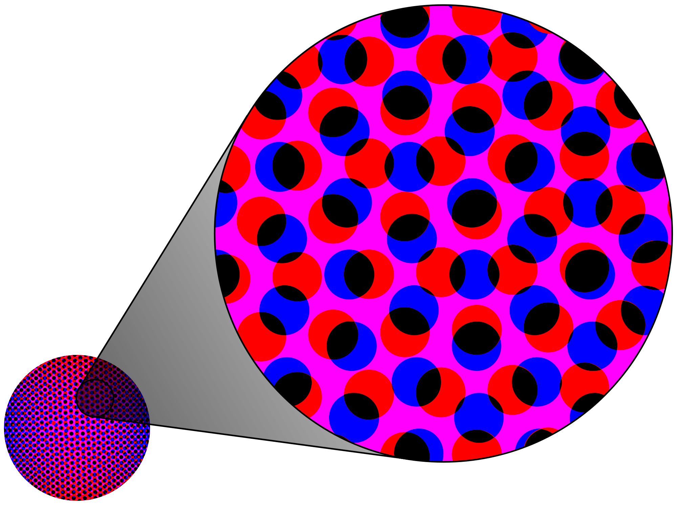
What are Ben Day Dots???
The Ben Day process, named after illustrator and printer Benjamin Henry Day Jr. is a printing technique that started in 1879.
Lichtenstein's technique, which often involved the use of stencils, sought to bring the look and feel of commercial printing processes to his work. Through the use of primary colors, thick outlines, and Benday dots, Lichtenstein endeavored to make his works appear machine-made.

Slide 9
What are we Doing???
Creating Lichtenstein-inspired art using onomatopoeias!
Play the “Roll a Lichtenstein” game to create 2 designs.
Look at some of the examples, plus your designs and come up with your own final idea. Next, color it in color pencil. Our final draft will look something like this….

Slide 15
