Slide 1
Functional Art

Slide 8
Pinch Pots

Slide 9
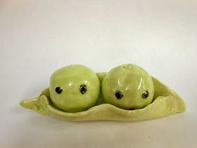

Slide 12
Pinch Pot Salt and Pepper Shakers
Divide page into 1/4th and create/color 4 possible designs
Think of things that contrast or compliment each other. Things that are similar but different. YOUR CHOICES MUST HAVE A THEME
Ex. Sun and moon
Yin Yang
Cats and Dogs
*MAKE SURE THERE ARE GLAZES FOR THE COLORS YOU CHOOSE*
VA COMP: USE AT LEAST 3 TEXTURES

