Slide 1
SHADING

Slide 3
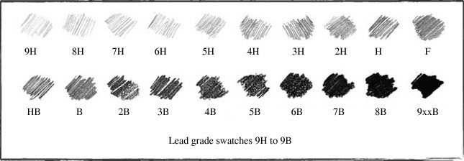
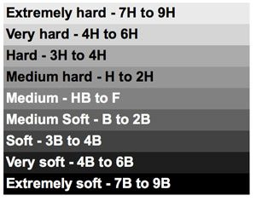
Shading Notes
H-
B-
HB-
Core Shadow-
Cast Shadow-
Light Source-
Highlight-
6B 4B 2B HB 2H 4H 6H
(#2 Pencil)

Slide 4
Shading Notes
H-
B-
HB-
Core Shadow- The core shadow is the dark band visible where light and shadow meet. It is the point at which light can no longer reach the form to illuminate it. It is the darkest area of the shadow on the sphere (the "form shadow")because it is least affected by reflected light.
Cast Shadow- The shadow on the surface that the object rests on. It is created by the object itself blocking the light from the light source. Falls opposite of the light source
Light Source- Where the light on your object comes from
Highlight- The light area of your object where the light source meets your object.
6B 4B 2B HB 2H 4H 6H
(#2 Pencil)

Slide 5
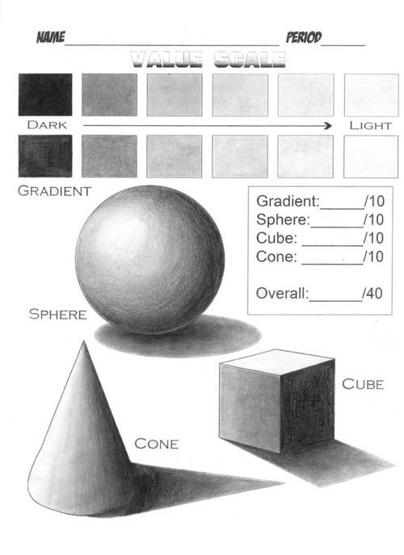

Slide 6
What We Are Doing:
Draw a value scale- 1” x 1” inch squares. 2H HB 4B
3 values of EACH pencil = 9 values
(LIGHT) (MED) (DARK)
Draw and shade a cube, cylinder, cone and sphere (4” x 4”) based off of handout
Cube and cylinder on 1 page, cone and sphere on another
DRAW LIGHT ‘TIL ITS RIGHT and NO SMUDGING WITH FINGER OILS. (I can tell)

Slide 7
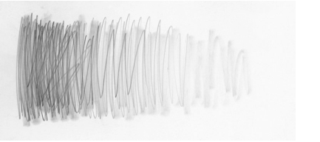
Don’t Scribble
No amount of blending will ever be able to make this scribbled application look smooth.

Slide 8
Smooth Lines from Dark to Light
This is what your pencil lines should look like before you begin blending. The individual lines are barely visible. Work from dark to light, going up and down and back and forth at the same time to help the liens fill in as you go.

Slide 9
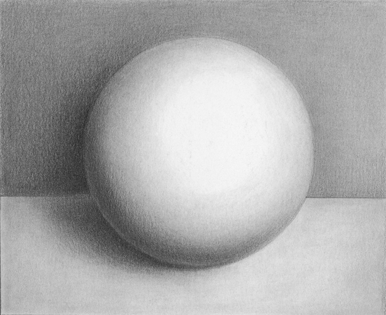
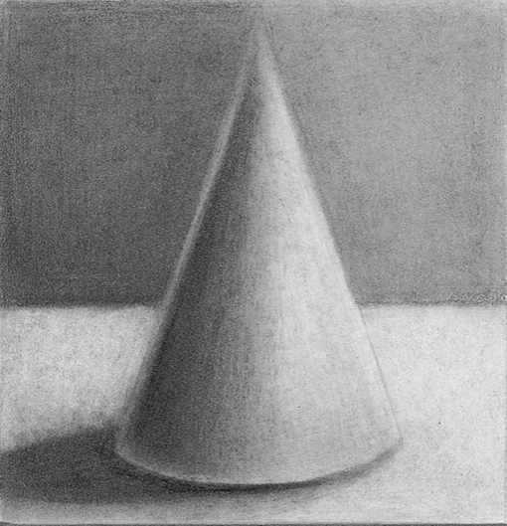
How To Shade
Follow the natural lines of the 3-D form
Overlap pencils to blend between values better
Shade in layers, working SLOWLY
EACH SHAPE IS WORTH 25 POINTS

Slide 10
Using a View Finder

Slide 11
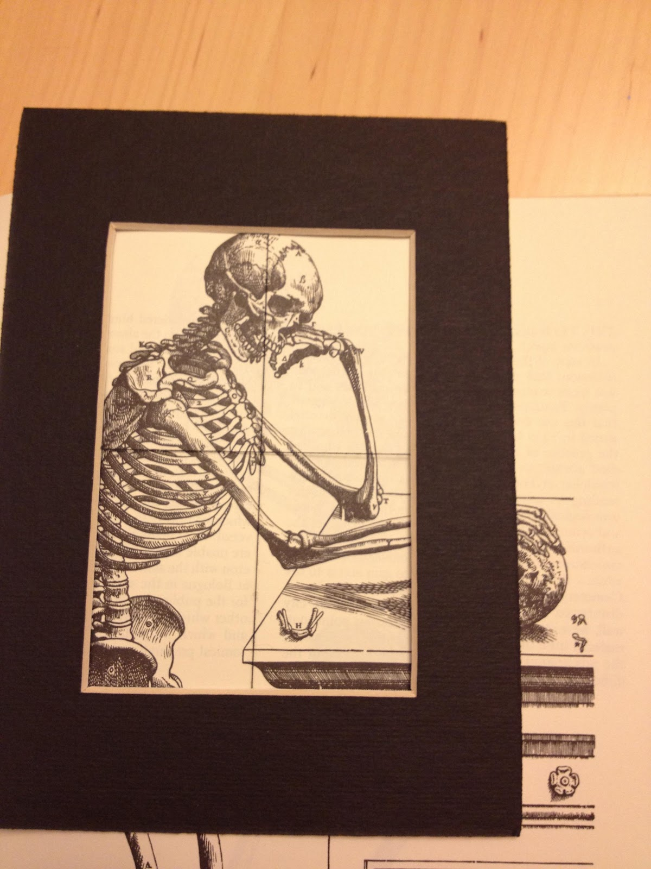

Slide 12
Use of View Finder
Observational skills, to “see” like an artist
Shading skills
Proportion
3D Rendering with Tone

