Slide 1
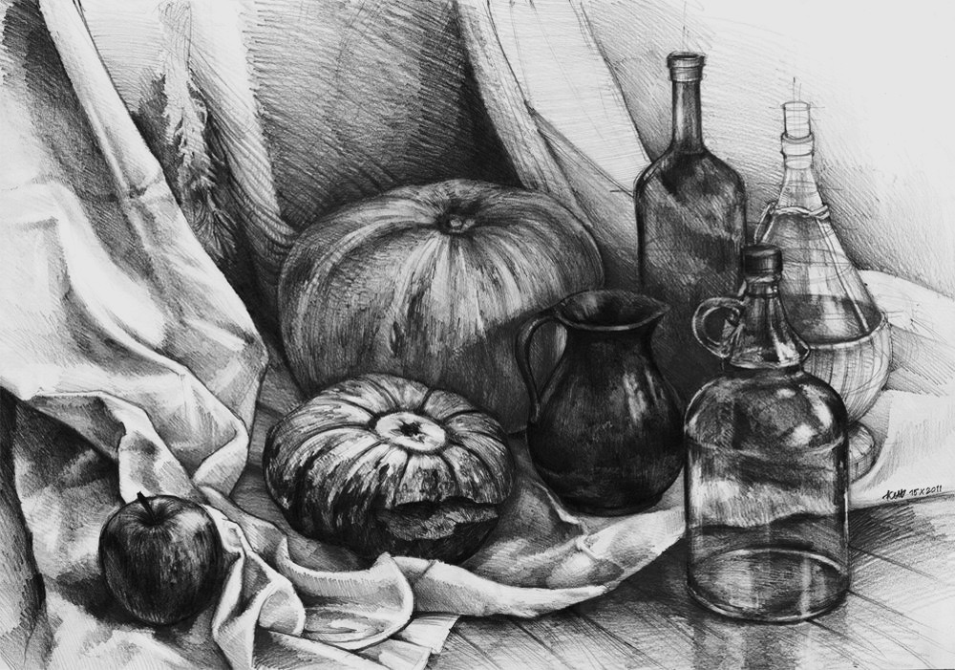
Still Life

Slide 2
Still Life
a painting or drawing of an arrangement of objects, typically including fruit and flowers and objects contrasting with these in texture, such as bowls and glassware

Slide 3
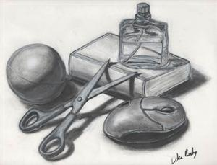
What We Will Be Doing
Create a still life with 5 complex objects around the classroom WITH PERMISSION.
1 Glass
1 Metal
1 Wood
1 Fabric
1 Free Choice
*Pro Tip- Take photo of arrangement so set up is easy the next day*

Slide 4
Why We Will Be Creating A “ Still Life” Drawing
Observational skills, to “see” like an artist
Shading skills
Proportion
3D Rendering with Tone

Slide 5
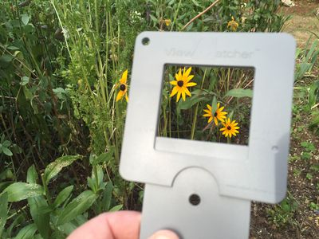
Using a View Finder

Slide 6
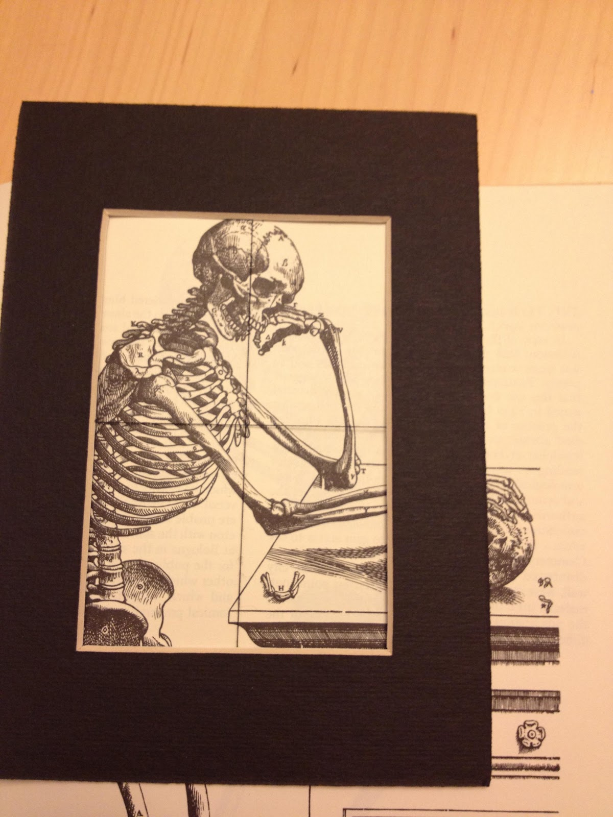

Slide 7
Use of View Finder
Observational skills, to “see” like an artist
Shading skills
Proportion
3D Rendering with Tone

Slide 8
What You Will Be Graded On
Observational skills, to “see” like an artist
Shading skill
Proportion
3D Rendering with Tone
Craftsmanship/ Time Management

Slide 9
Shading Practice

Slide 10
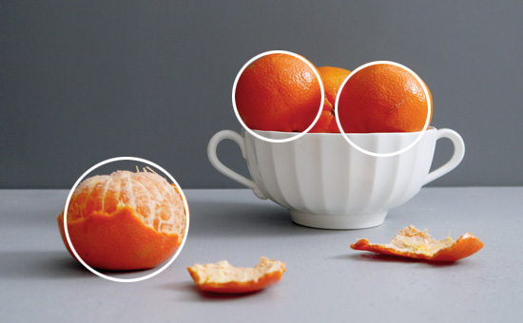
Day 1: Proportion.
Start with the large, simple shapes and “Block” them in.
Pay attention to Proportion (size relation)
Make sure drawing touches 3 edges of the paper

Slide 11
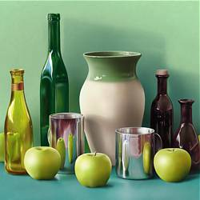
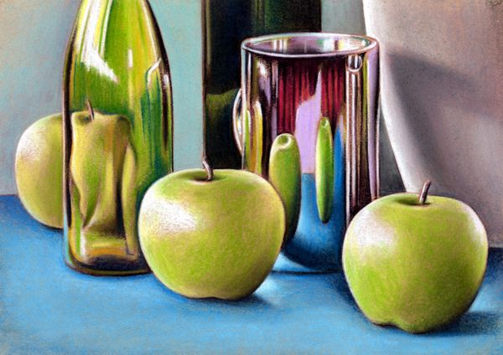
Day 1 Tips:
Draw COMPOSITION or LAYOUT as if you are “Zooming In” in order to fill page (off 3 edges)
Remember to draw what you SEE, not what you KNOW
Shapes: Ex. a Circle may look like an oval from a different angle
Proportion: A soda can is shorter than a bottle of water. BUT if the can is CLOSER to your view, it may appear BIGGER.
DON’T STACK TOO HIGH. You wont be able to go off 3 edges if the objects are stacked too tall.

Slide 14
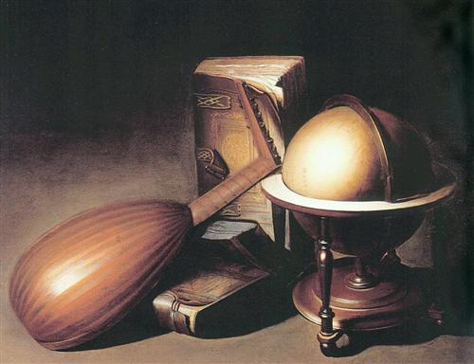
Sighting Techniques
Negative Space
Negative Space is the area AROUND an object.
Sometimes it helps to look at those shapes
when “blocking in” your objects.

Slide 15
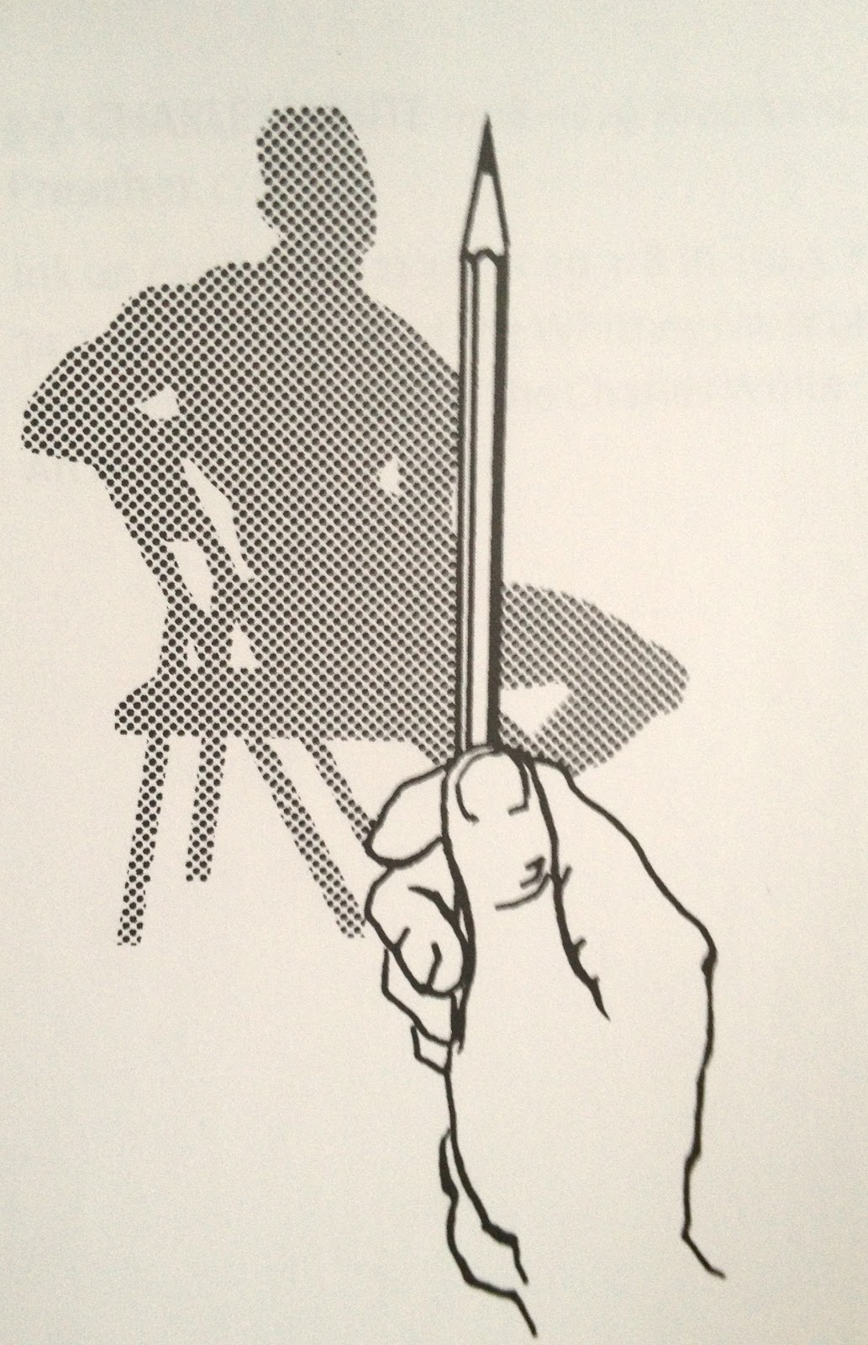
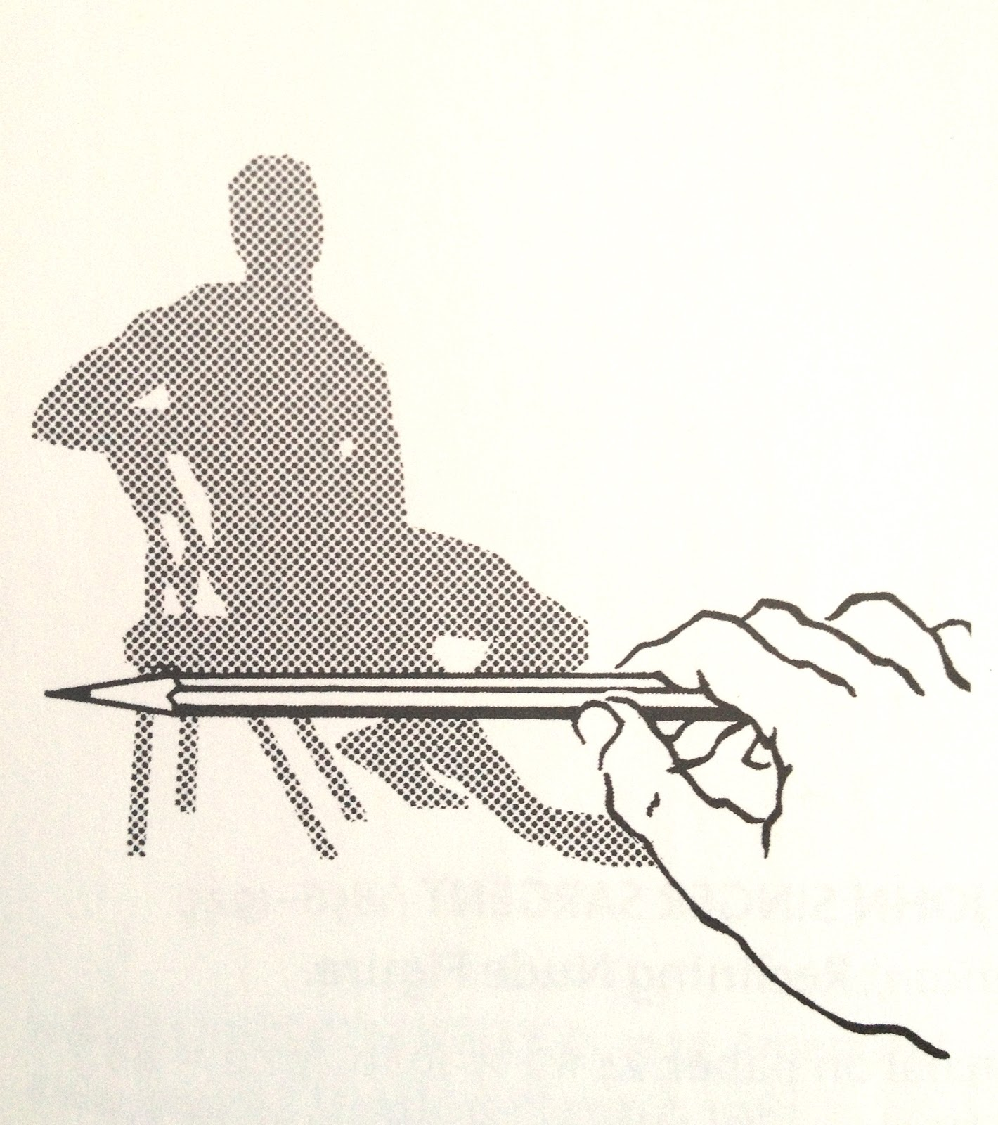
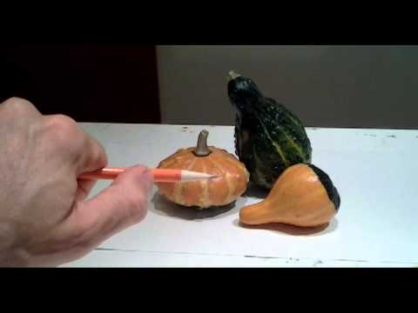
Sighting Techniques
Thumbnail Measuring
Thumbnail measuring is using your thumbnail and pencil to check the proportions of different areas or objects within a still life.
Ex. See what should be EQUAL in size and adjust drawing accordingly.
Make sure your arm is locked into place. (if you move it, closer in or further out, it will measure size inaccurately)

Slide 16
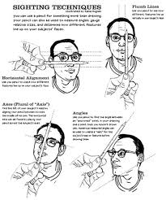
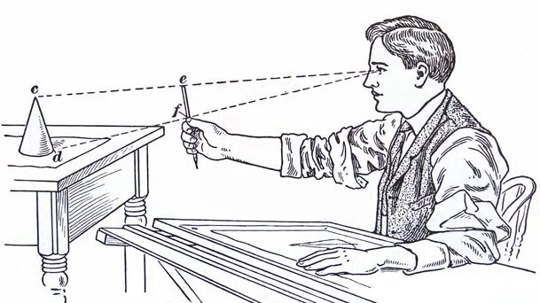
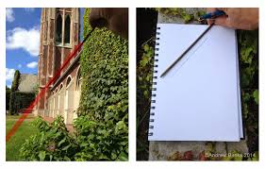
Sighting Techniques
Thumbnail Measuring
Thumbnail measuring is using your thumbnail and pencil to check the proportions of different areas or objects within a still life.
Ex. See what should be EQUAL in size and adjust drawing accordingly.
Make sure your arm is locked into place. (if you move it, closer in or further out, it will measure size inaccurately)

Slide 17
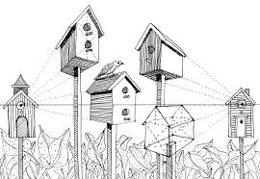
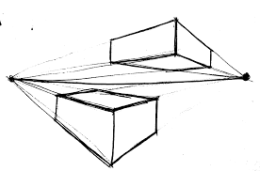
Day 2: Perspective
The art of drawing solid objects on a two-dimensional surface so as to give the right impression of their height, width, depth, and position in relation to each other when viewed from a particular point.

Slide 18
How To and Other Tips
Remember that some shapes change based on angle.
(Ex. A circle may only be a circle from the top view. It will flatten or stretch as the angle changes).

Slide 19
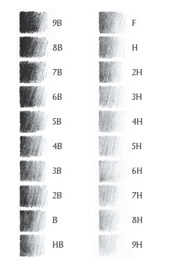
Day 3-4: Shading
Shading- Pay attention to light source.
2H- Use for LIGHT shading
HB (#2 Pencil)- Use for MEDIUM shading
4B- Use for DARK shading
Start LIGHT, then LAYER.
You can always add more but can only take off so much.

Slide 20
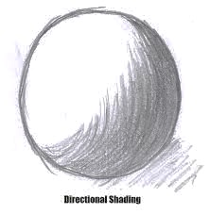
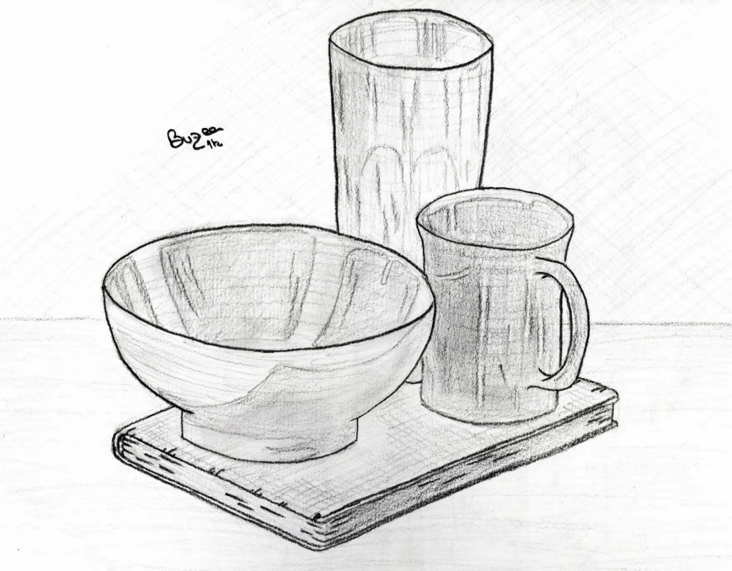
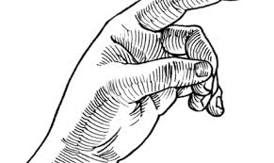
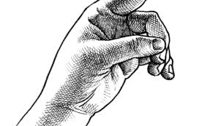
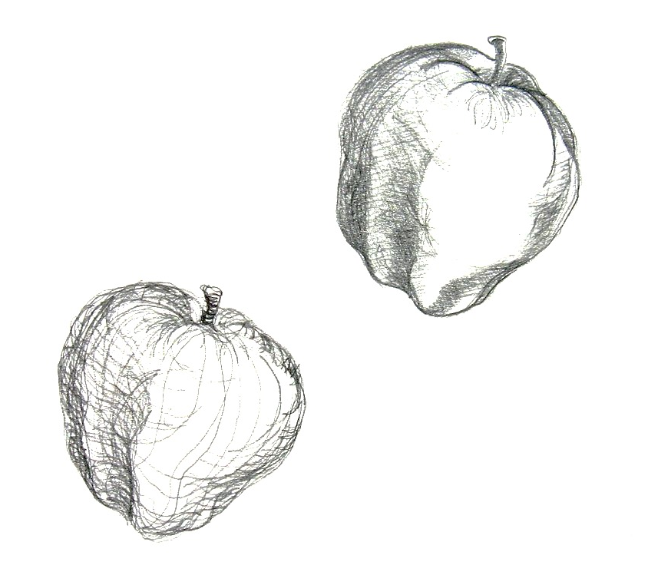
Directional Mark-Making
As you continue shading, pay attention to the shape of the form (3D Object) that you are drawing and use Directional Mark-Making – add shading or tiny lines to show bends and curves of objects

Slide 21
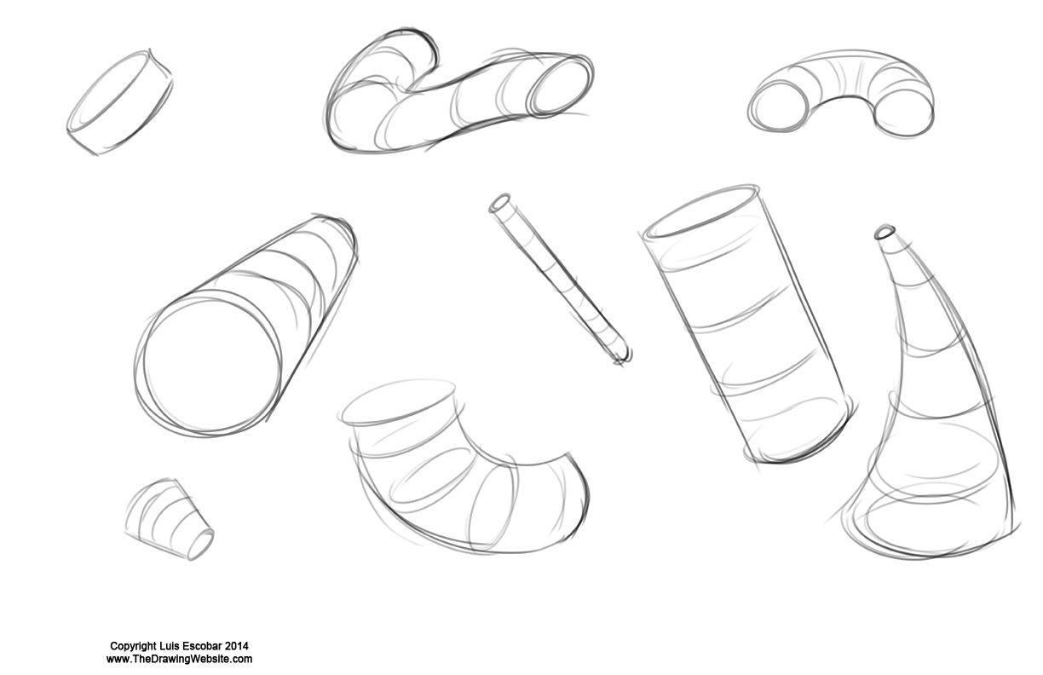
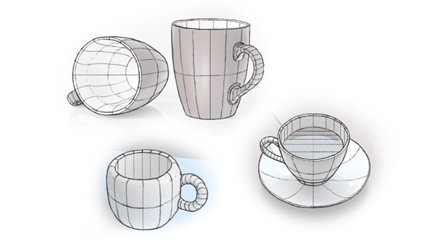
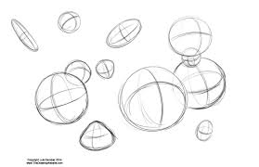
You Can Start with Contour Lines

Slide 22
Tortillions

Slide 24
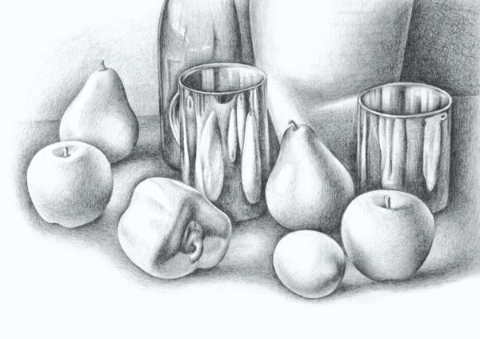

Slide 25
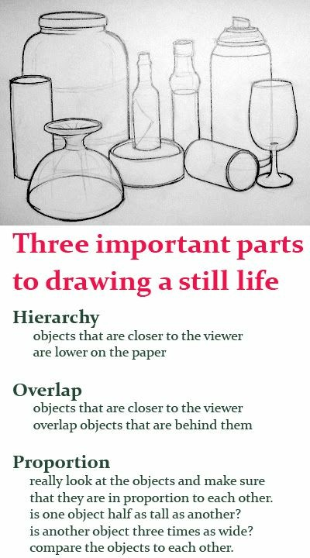
Day 5: Double check

