Slide 1
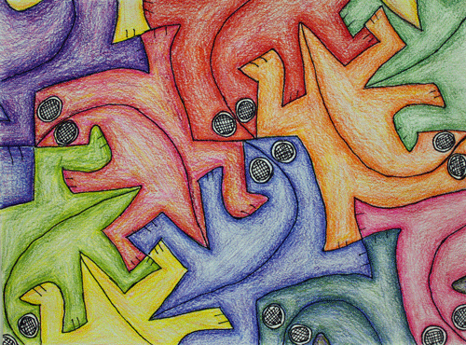
Tessellations

Slide 8
https://www.youtube.com/watch?v=f7kW8xd8p4s
https://www.youtube.com/watch?v=1CYrGpd8k5w

