Slide 1
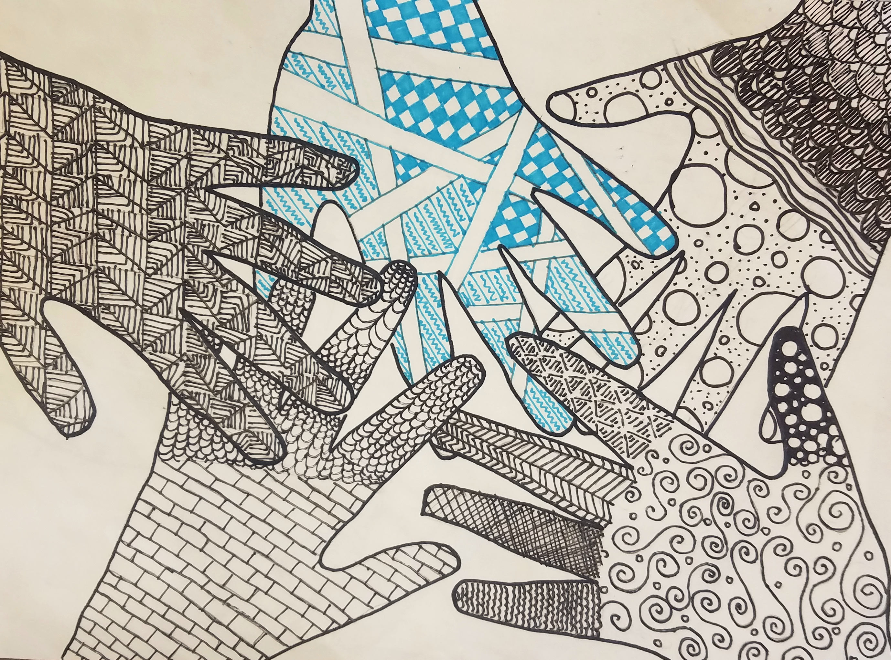
“Zentangle” Hands
Using Lines to Create Value

Slide 3
What is Value?
Value is the range of light to dark

Slide 4
How can an artist use lines to show value?

Slide 5
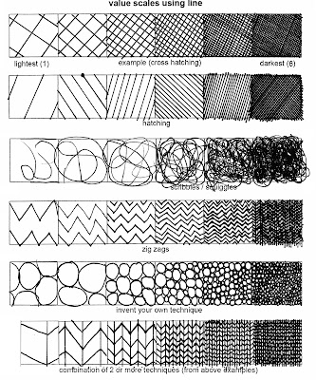

Slide 6
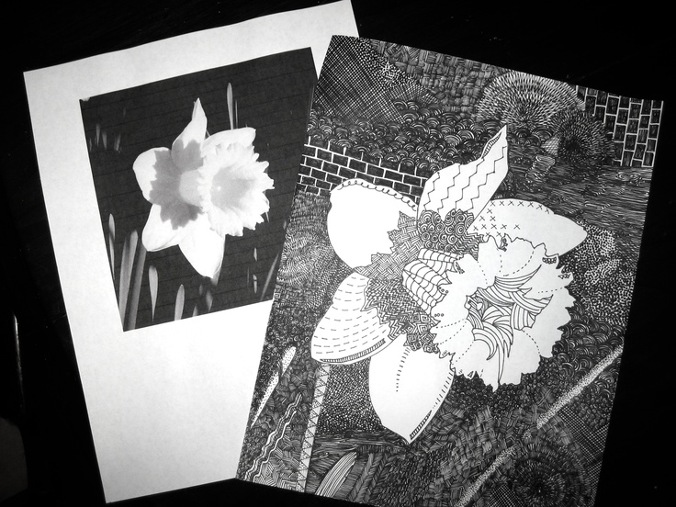

Slide 7
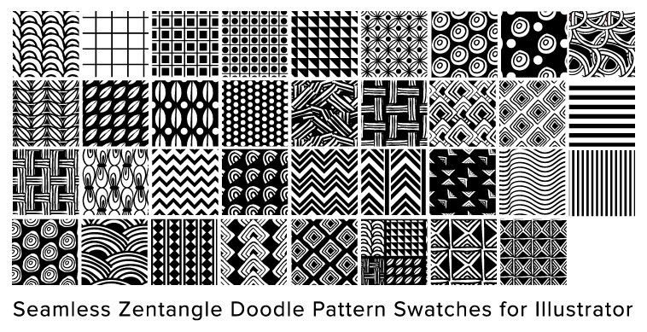

Slide 8
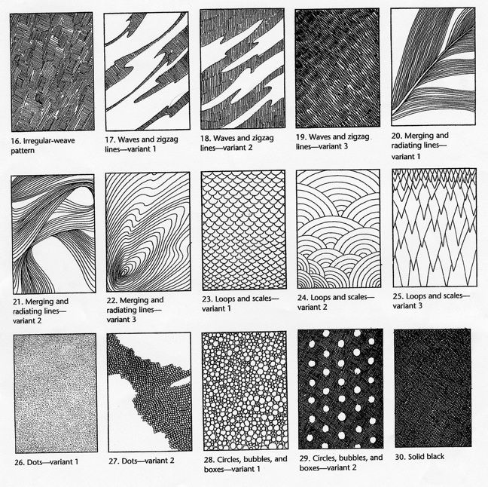

Slide 9
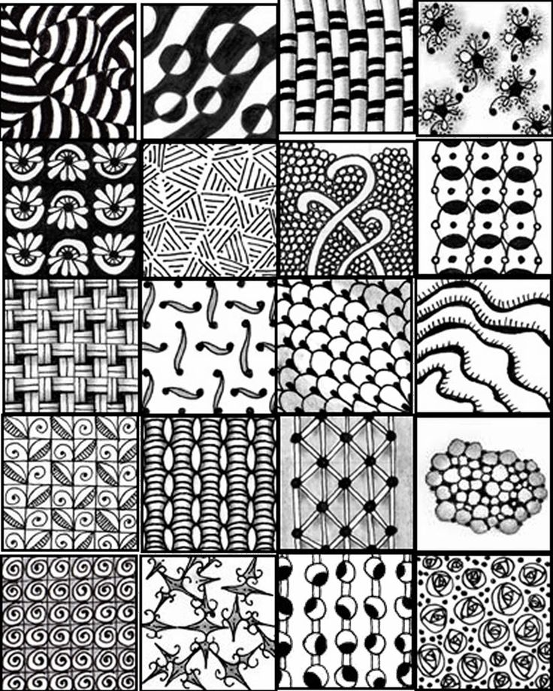

Slide 10
