Slide 1
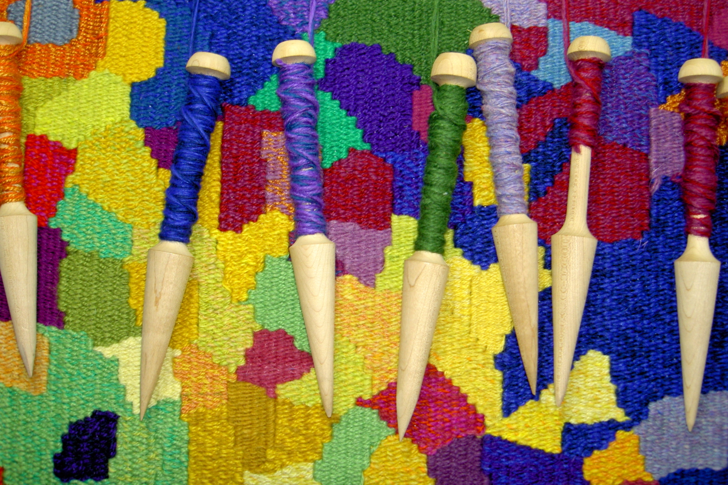
Textile/ Fiber Arts

Slide 2
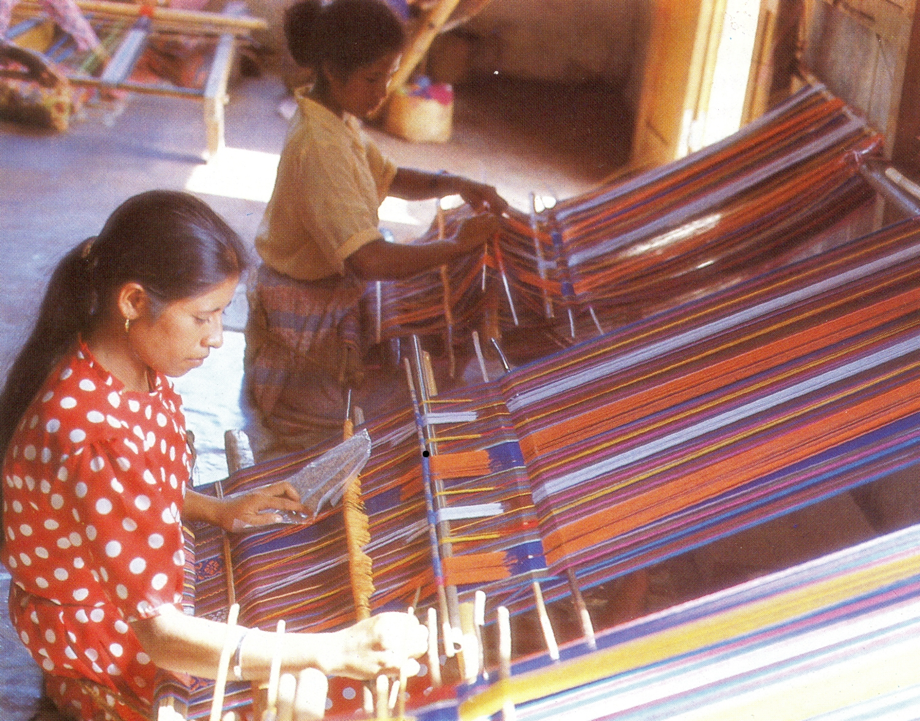

Slide 8
Vocabulary
Loom- The frame used for weaving fabric
Warp- The strong, tight threads that are stretched onto a loom for weaving
Weft- The fibers that are woven into the warp to create a fabric
Fiber- Any long flexible material
Tapestry- A weaving that uses shapes creatively
Tension- The degree of tightness of the warp or weft in weaving

Slide 9
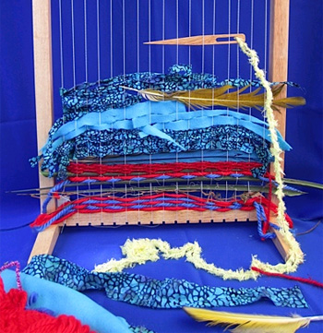

Slide 20
https://www.youtube.com/watch?v=r9kJKAW6jKg

