Slide 1
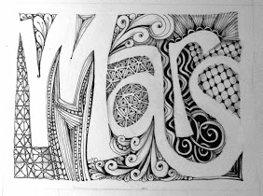
“Zentangle” Initial
Using Lines to Create Value

Slide 3
What is Value?
Value is the range of light to dark

Slide 4
How can an artist use lines to show value?

Slide 5
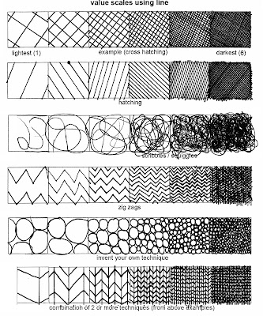

Slide 6
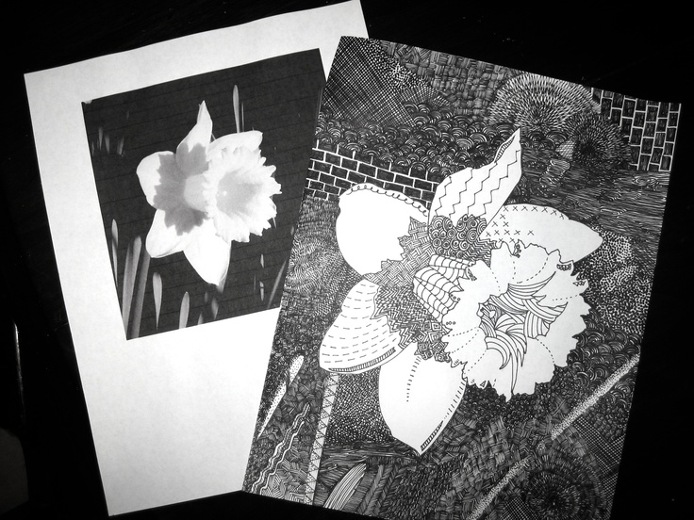

Slide 7
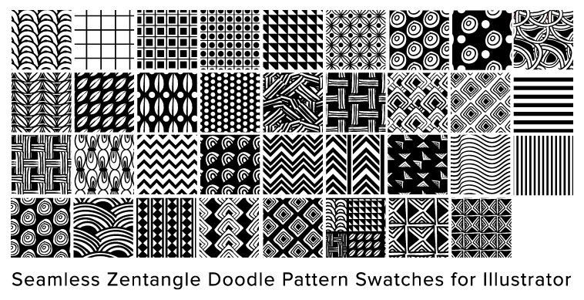

Slide 8
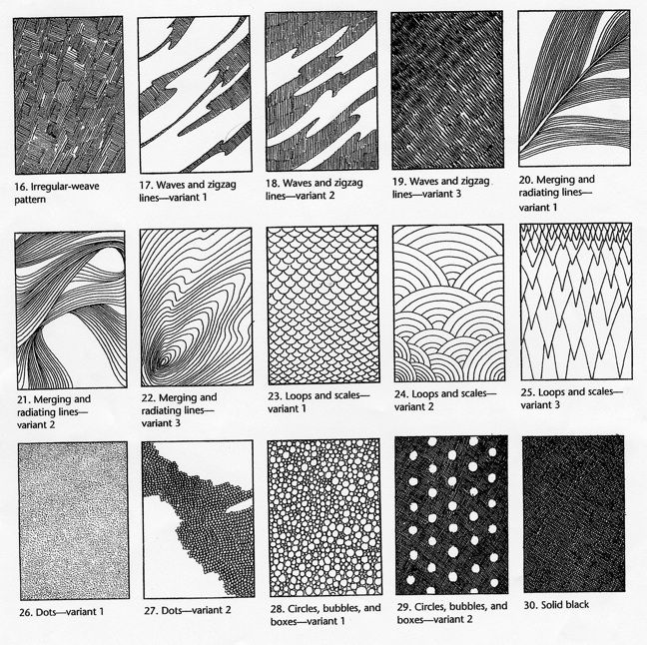

Slide 9
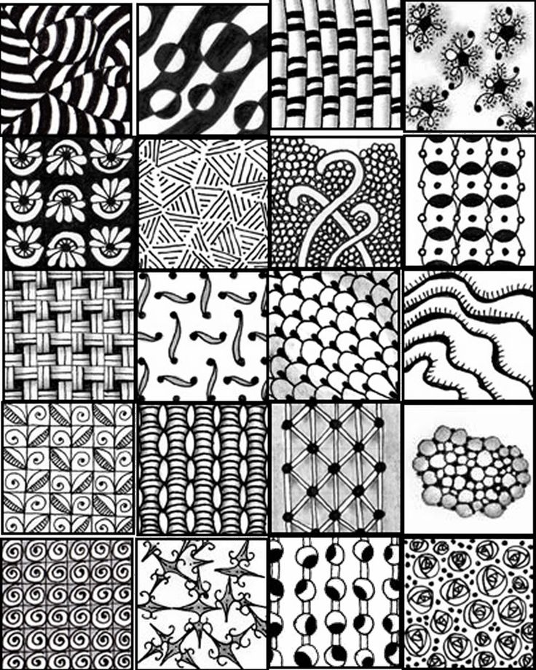

Slide 10
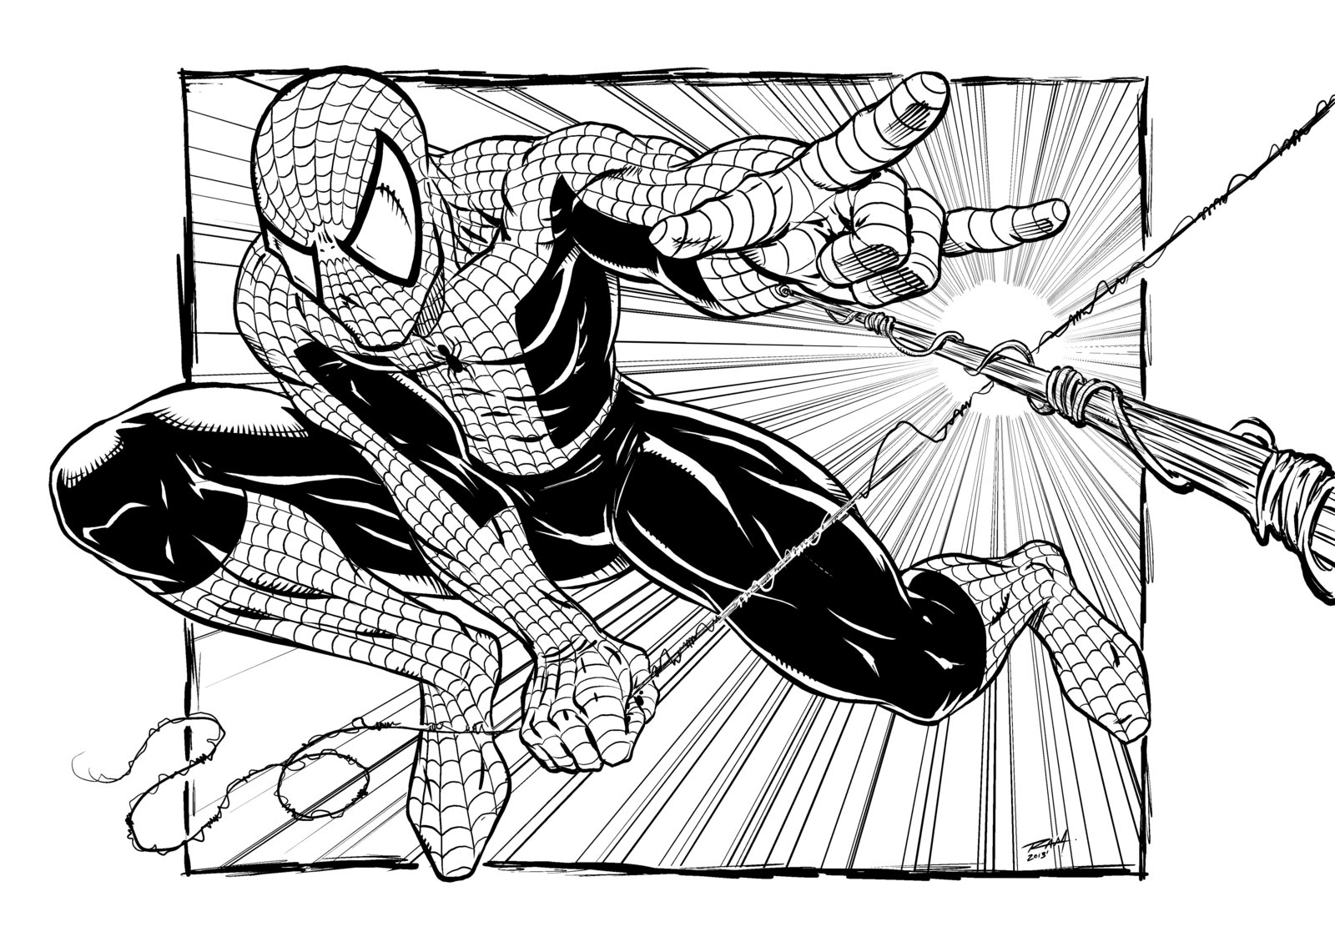

Slide 11
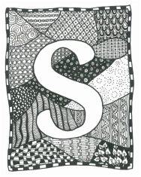

Slide 12
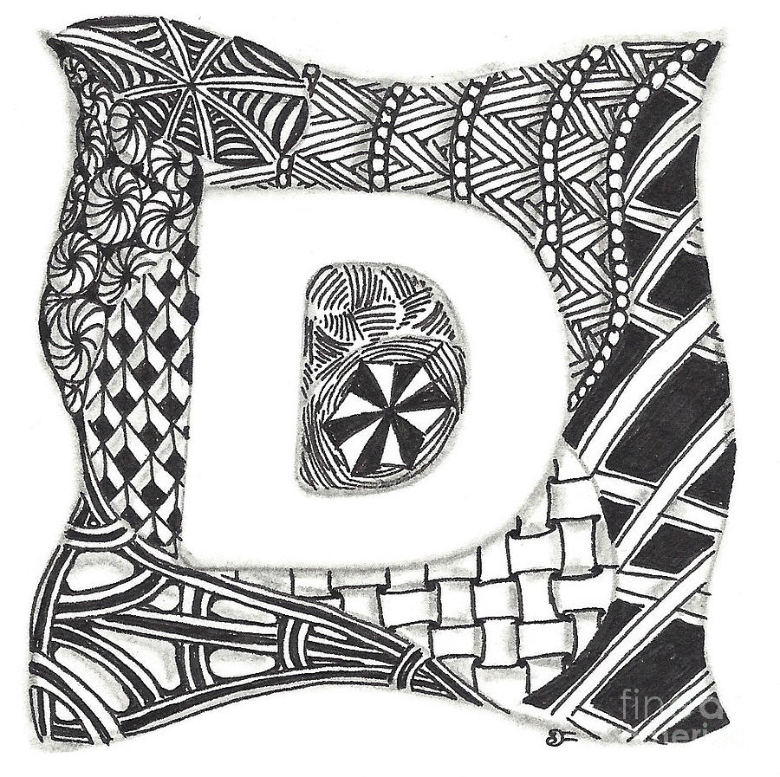
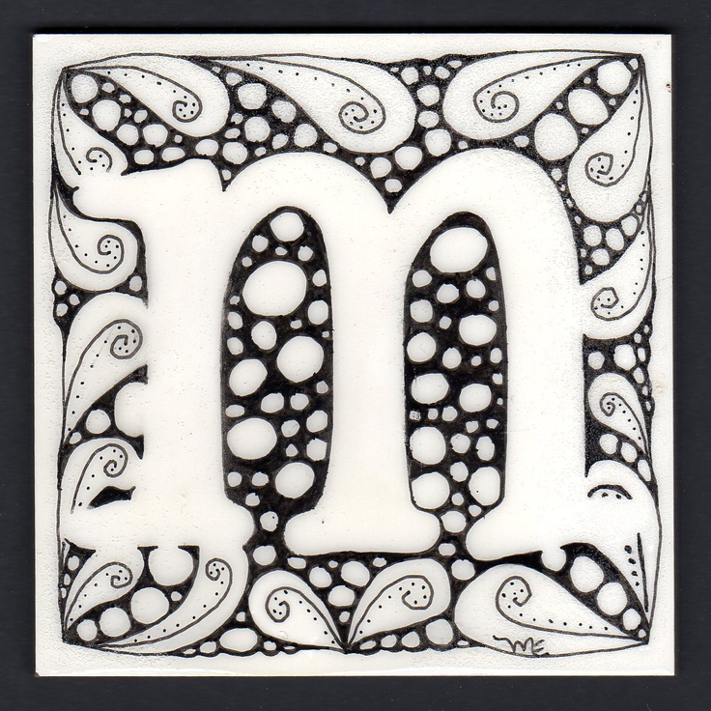

Slide 13
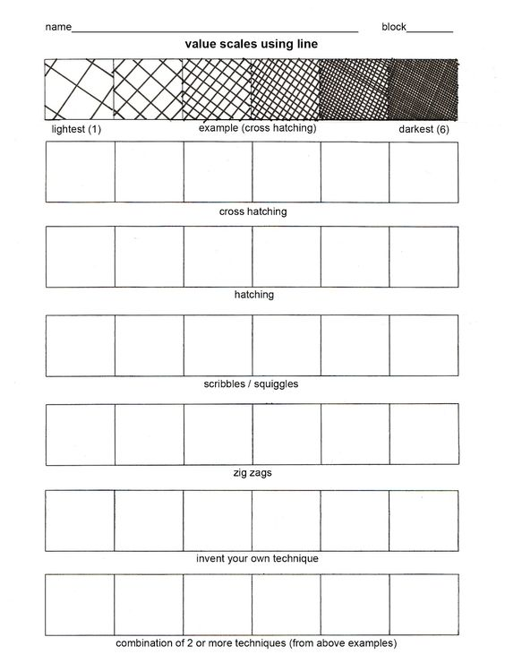
What are WE doing?
Practice creating value scales

Slide 14
Requirements
MUST use AT LEAST 5-7 patterns
MUST show stippling AND cross-hatching
MUST use negative and positive space well
Initial MUST fill majority of paper

